Slide 1

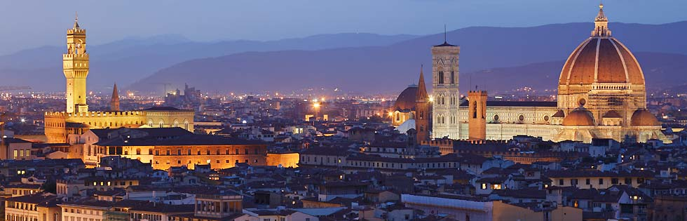

Project LIFE13 ENV/IT/000461
“Environmentally friendly biomolecules from agricultural wastes as substitutes
of pesticides for plant diseases control”
“EVERGREEN”
Start: 01/10/2014
End: 30/09/2016
EVERGREEN 24th month Meeting
2016, September 23rd
Mondo Verde Casa e Giardino srl
Scarperia

Slide 2
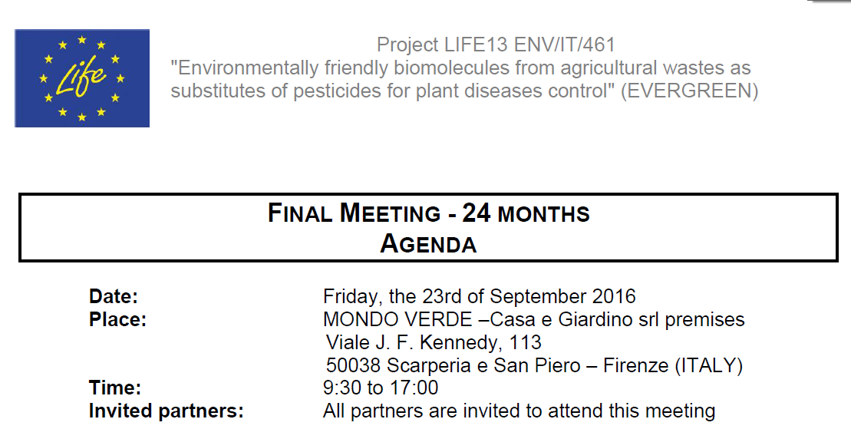

Slide 3
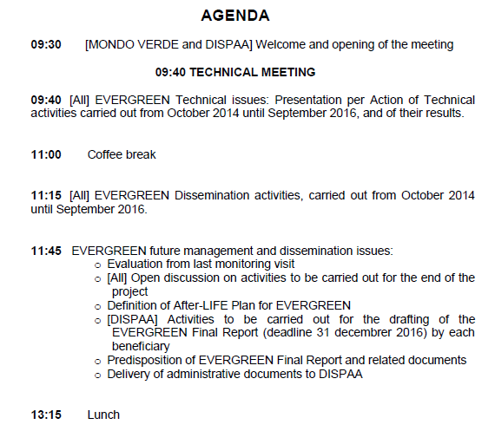

Slide 4
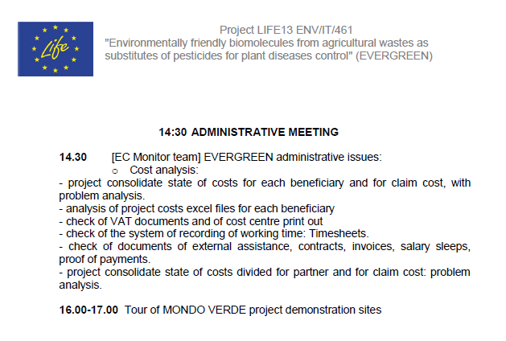

Slide 5







Slide 6



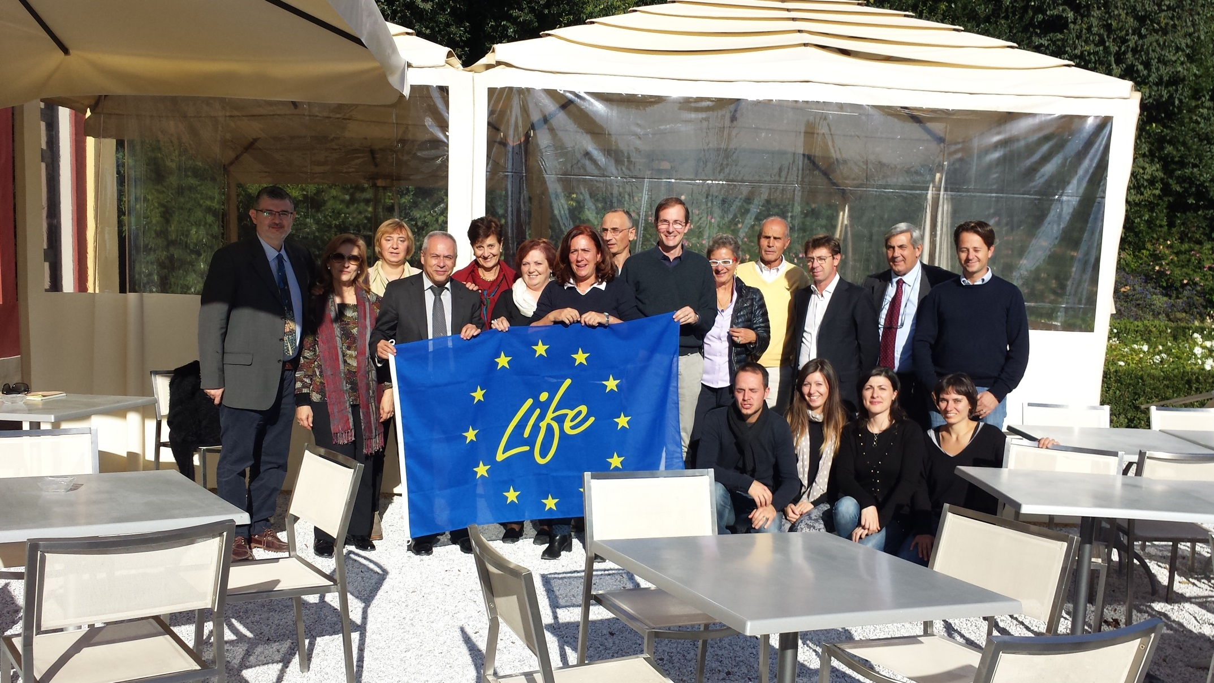

Slide 7

LIFE13 ENV/IT/000461 – EVERGREEN
24th month Meeting
2016, September 23rd
Mondo Verde srl
?

Slide 8
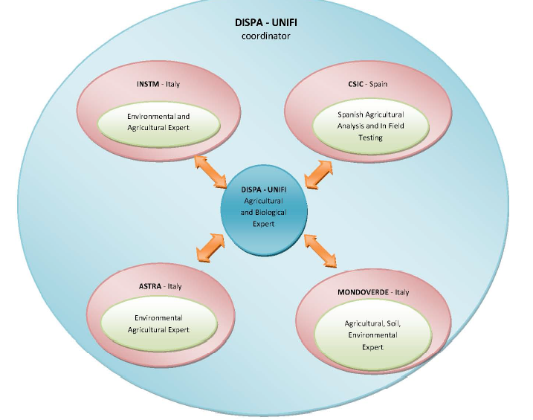
LIFE13 ENV/IT/000461 – EVERGREEN
24th month Meeting
2016, September 23rd
Mondo Verde srl
B1, B2, B3, B4, B5, B7
B1, B2, B3, B4, B5, B6, B7
(B4) B7
(B4) B7

Slide 9
LIFE13 ENV/IT/000461 – EVERGREEN
24th month Meeting
2016, September 23rd
Mondo Verde srl
C1, C5
C1, C2, C3, C4, C6, C7
(C1) C7
C1, C5

Slide 10
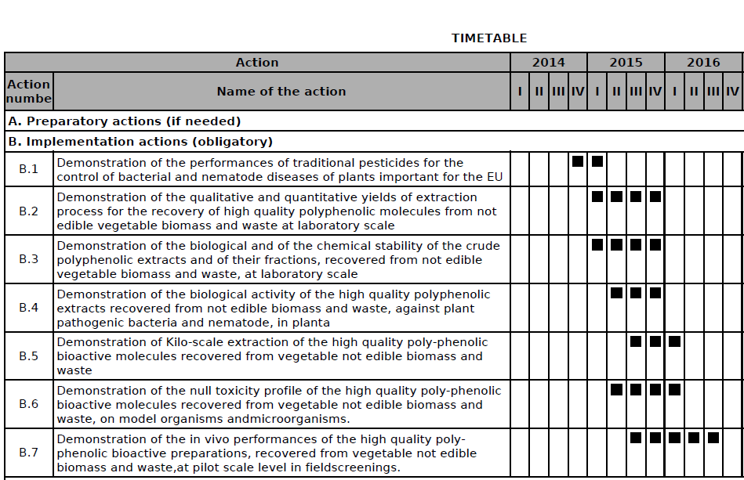
LIFE13 ENV/IT/000461 – EVERGREEN
24th month Meeting
2016, September 23rd
Mondo Verde srl

Slide 11
LIFE13 ENV/IT/000461 – EVERGREEN
24th month Meeting
2016, September 23rd
Mondo Verde srl

Slide 12

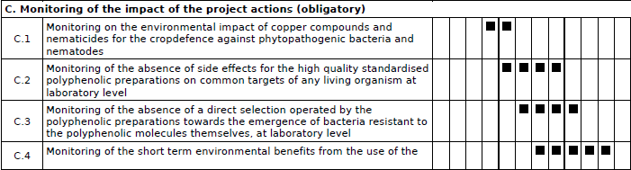
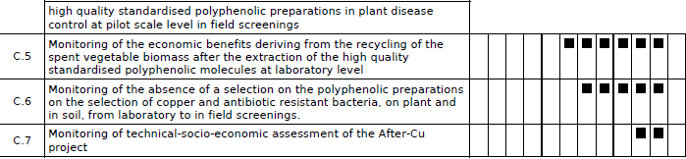
LIFE13 ENV/IT/000461 – EVERGREEN
24th month Meeting
2016, September 23rd
Mondo Verde srl

Slide 13
LIFE13 ENV/IT/000461 – EVERGREEN
24th month Meeting
2016, September 23rd
Mondo Verde srl

Slide 14

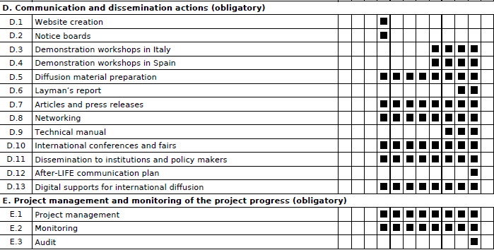
LIFE13 ENV/IT/000461 – EVERGREEN
24th month Meeting
2016, September 23rd
Mondo Verde srl

Slide 15
LIFE13 ENV/IT/000461 – EVERGREEN
24th month Meeting
2016, September 23rd
Mondo Verde srl

Slide 16
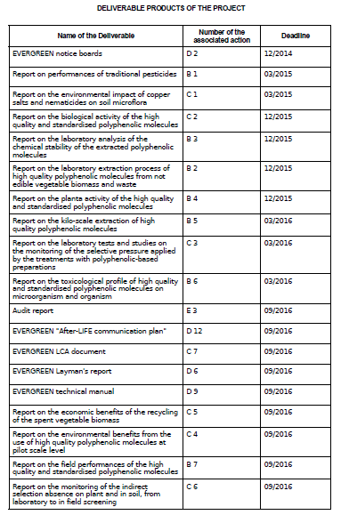
LIFE13 ENV/IT/000461 – EVERGREEN
24th month Meeting
2016, September 23rd
Mondo Verde srl

Slide 17
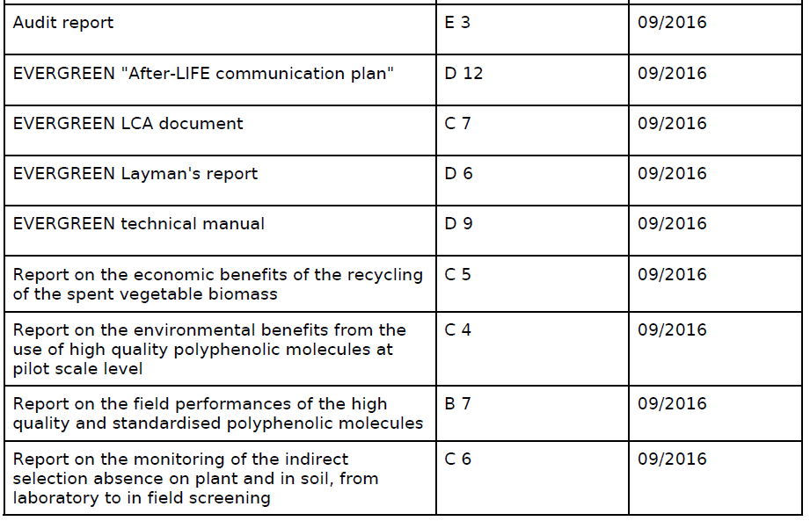
LIFE13 ENV/IT/000461 – EVERGREEN
24th month Meeting
2016, September 23rd
Mondo Verde srl

Slide 18
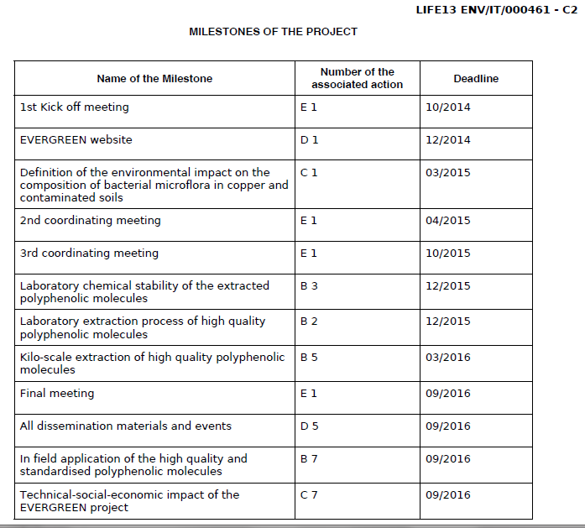
LIFE13 ENV/IT/000461 – EVERGREEN
24th month Meeting
2016, September 23rd
Mondo Verde srl

Slide 19
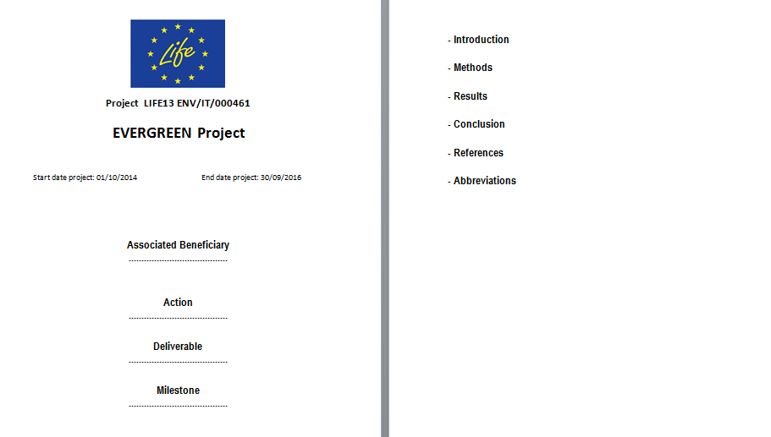
LIFE13 ENV/IT/000461 – EVERGREEN
24th month Meeting
2016, September 23rd
Mondo Verde srl
EVERGREEN form for Monthly/Periodical reports

Slide 20
LIFE13 ENV/IT/000461 – EVERGREEN
24th month Meeting
2016, September 23rd
Mondo Verde srl
Action B1
1st October 2014 - 31st March 2015
Demonstration of the performances of traditional pesticides for the control of bacterial and nematode diseases of plants important for the EU

Slide 21
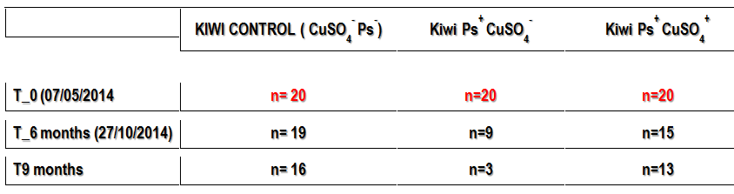
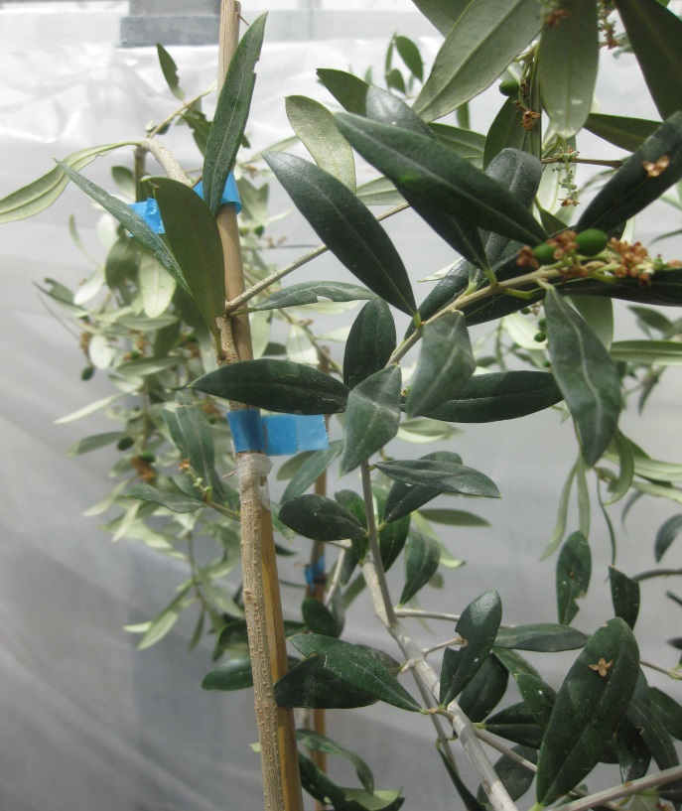
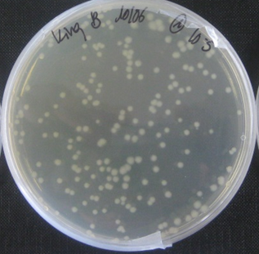
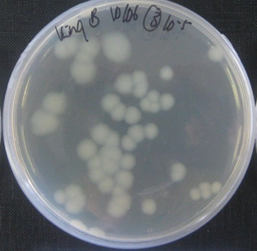
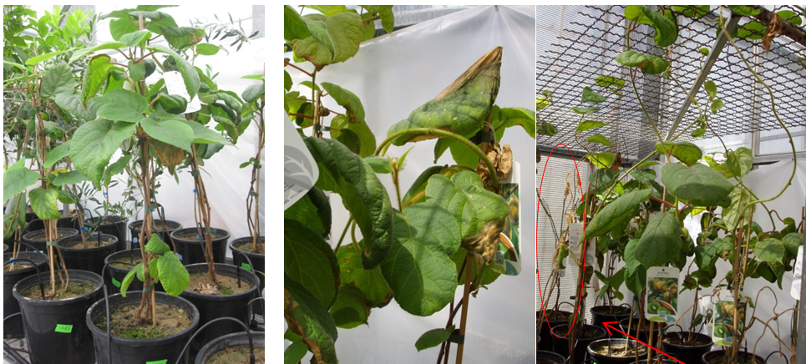
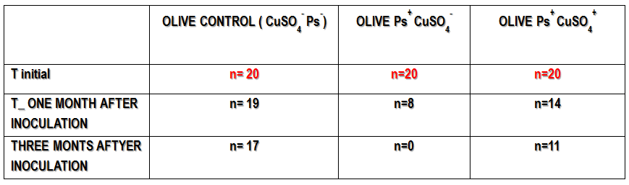
LIFE13 ENV/IT/000461 – EVERGREEN
24th month Meeting
2016, September 23rd
Mondo Verde srl
Action B1
1st October 2014 - 31st March 2015

Slide 22
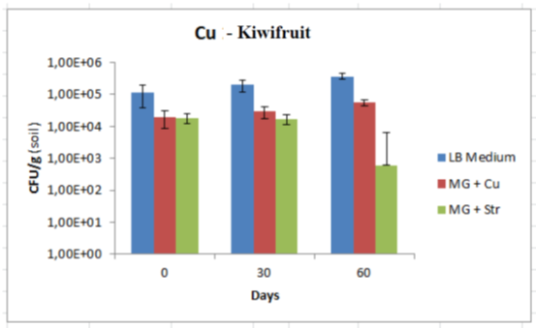
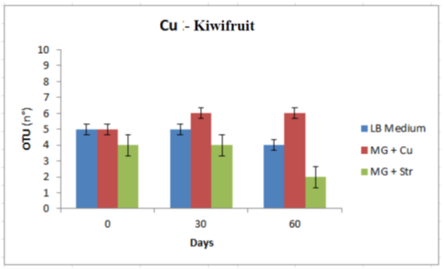
LIFE13 ENV/IT/000461 – EVERGREEN
24th month Meeting
2016, September 23rd
Mondo Verde srl
Action B1
1st October 2014 - 31st March 2015

Slide 23

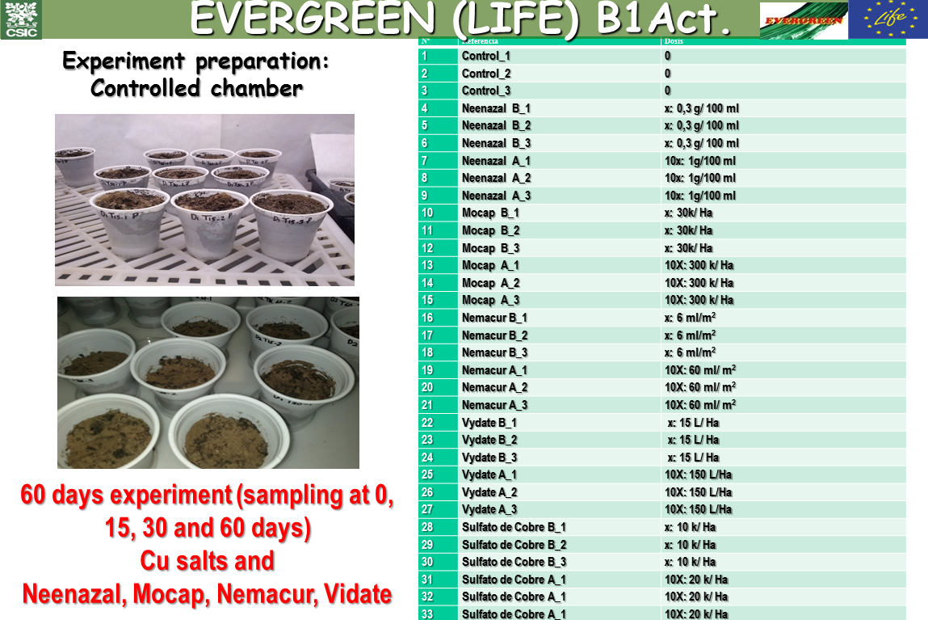
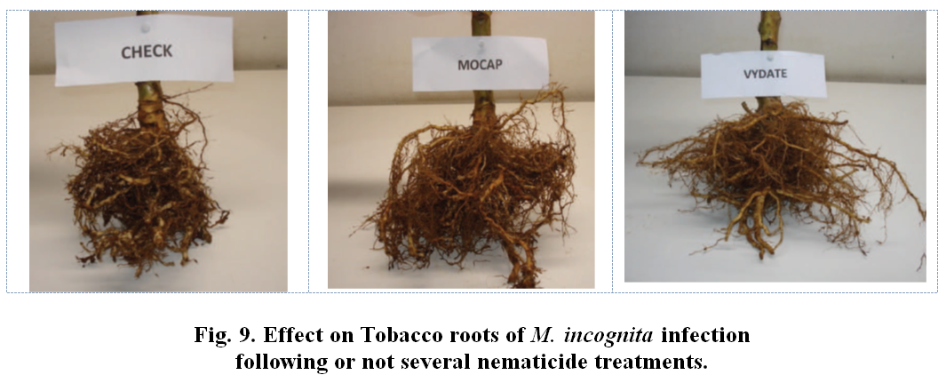
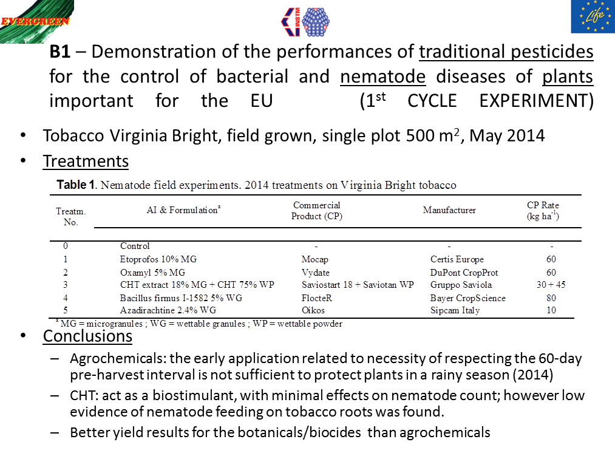
LIFE13 ENV/IT/000461 – EVERGREEN
24th month Meeting
2016, September 23rd
Mondo Verde srl
Action B1
1st October 2014 - 31st March 2015

Slide 24
LIFE13 ENV/IT/000461 – EVERGREEN
24th month Meeting
2016, September 23rd
Mondo Verde srl
Action B2
1st January 2015 - 31st December 2015
Demonstration of the qualitative and quantitative yields of extraction process for the recovery of high quality polyphenolic molecules from
not edible vegetable biomass and waste at laboratory scale

Slide 25
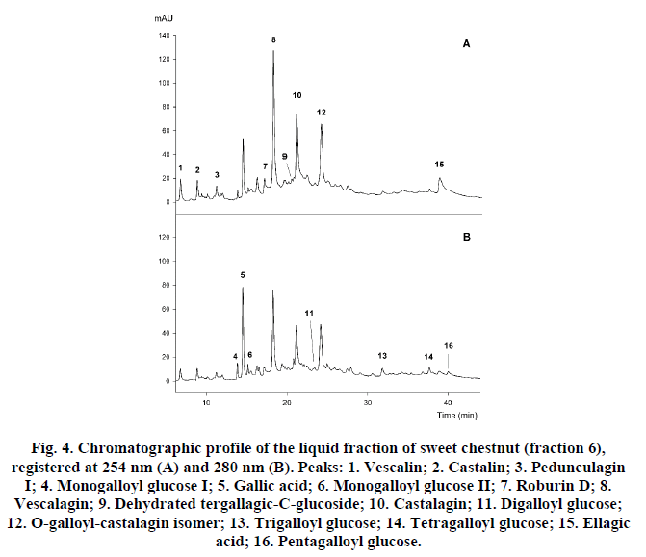
LIFE13 ENV/IT/000461 – EVERGREEN
24th month Meeting
2016, September 23rd
Mondo Verde srl
Action B2
1st January 2015 - 31st December 2015

Slide 26
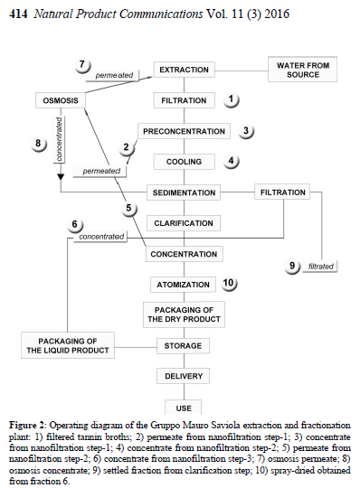
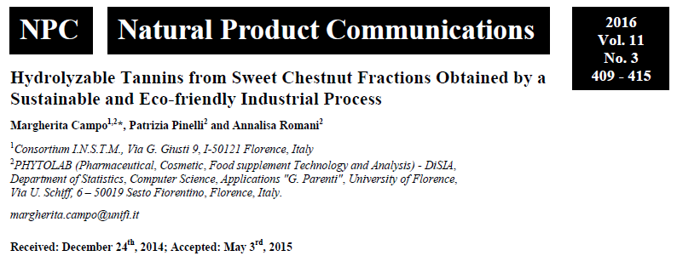
LIFE13 ENV/IT/000461 – EVERGREEN
24th month Meeting
2016, September 23rd
Mondo Verde srl
Action B2
1st January 2015 - 31st December 2015

Slide 27
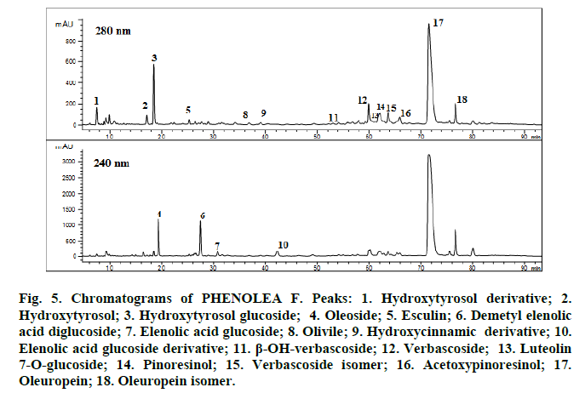
LIFE13 ENV/IT/000461 – EVERGREEN
24th month Meeting
2016, September 23rd
Mondo Verde srl
Action B2
1st January 2015 - 31st December 2015

Slide 28
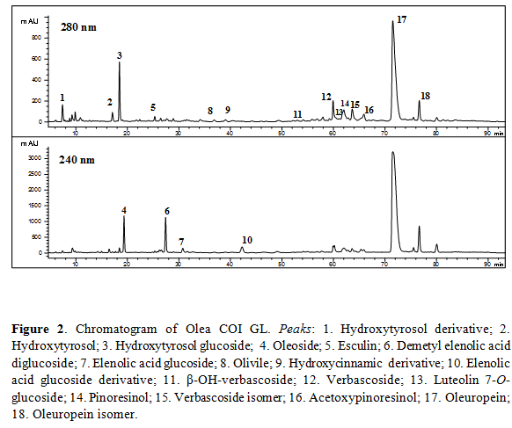
LIFE13 ENV/IT/000461 – EVERGREEN
24th month Meeting
2016, September 23rd
Mondo Verde srl
Action B2
1st January 2015 - 31st December 2015

Slide 29
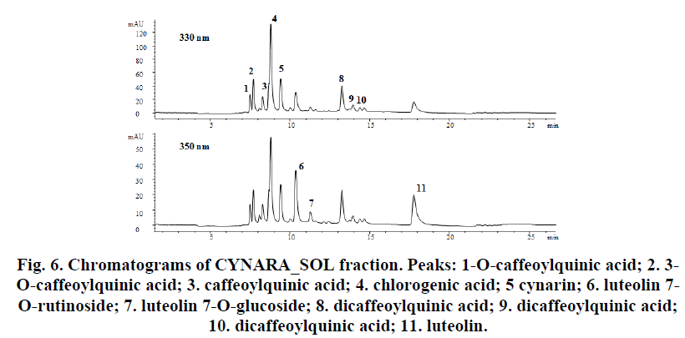
LIFE13 ENV/IT/000461 – EVERGREEN
24th month Meeting
2016, September 23rd
Mondo Verde srl
Action B2
1st January 2015 - 31st December 2015

Slide 30
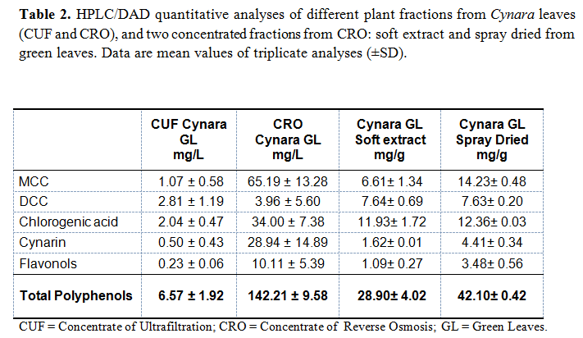
LIFE13 ENV/IT/000461 – EVERGREEN
24th month Meeting
2016, September 23rd
Mondo Verde srl
Action B2
1st January 2015 - 31st December 2015

Slide 31
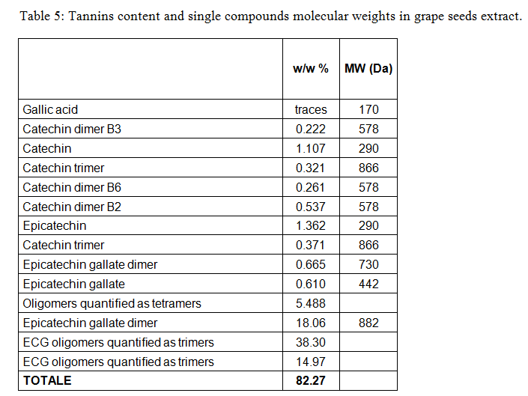
LIFE13 ENV/IT/000461 – EVERGREEN
24th month Meeting
2016, September 23rd
Mondo Verde srl
Action B2
1st January 2015 - 31st December 2015

Slide 32
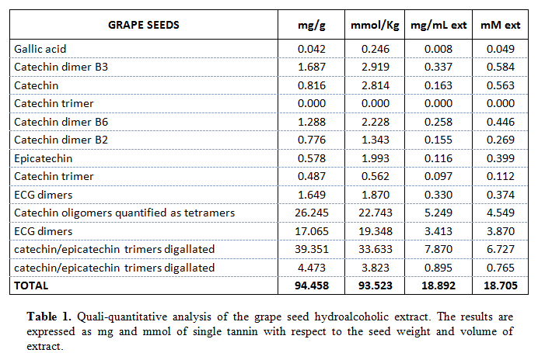
LIFE13 ENV/IT/000461 – EVERGREEN
24th month Meeting
2016, September 23rd
Mondo Verde srl
Action B2
1st January 2015 - 31st December 2015

Slide 33
LIFE13 ENV/IT/000461 – EVERGREEN
24th month Meeting
2016, September 23rd
Mondo Verde srl
Action B3
1st January 2015 - 31st December 2015
Demonstration of the biological and of the chemical stability of the crude polyphenolic extracts and of their fractions,
recovered from not edible
vegetable biomass and waste, at laboratory scale

Slide 34
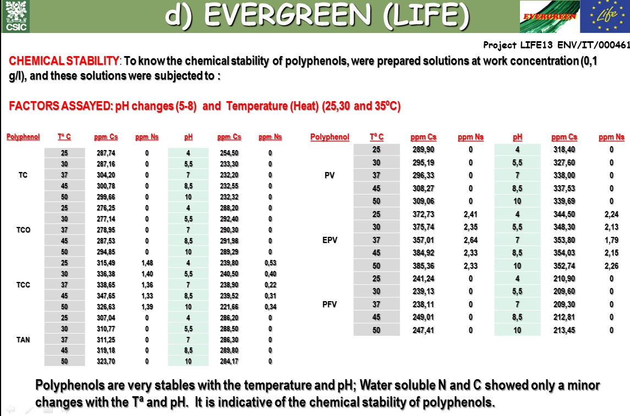
LIFE13 ENV/IT/000461 – EVERGREEN
24th month Meeting
2016, September 23rd
Mondo Verde srl
Action B3
1st January 2015 - 31st December 2015

Slide 35
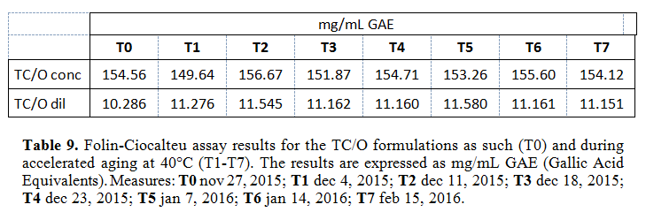
LIFE13 ENV/IT/000461 – EVERGREEN
24th month Meeting
2016, September 23rd
Mondo Verde srl
Action B3
1st January 2015 - 31st December 2015
TC/O conc (concentrated solution): Sweet Chestnut liquid fraction (20%)/Olea liquid fraction 3.22% polyphenols (10%) [to dilute to 100 for use].
2) TC/O dil (diluted solution): Sweet Chestnut liquid fraction (2%)/Olea liquid fraction 3.22% polyphenols (1%) [to dilute to 10 for use].

Slide 36
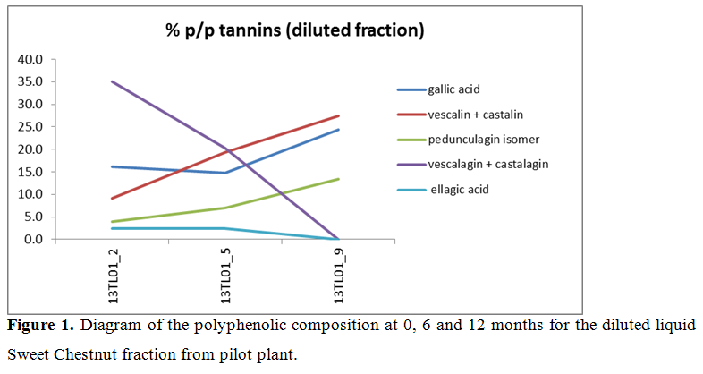
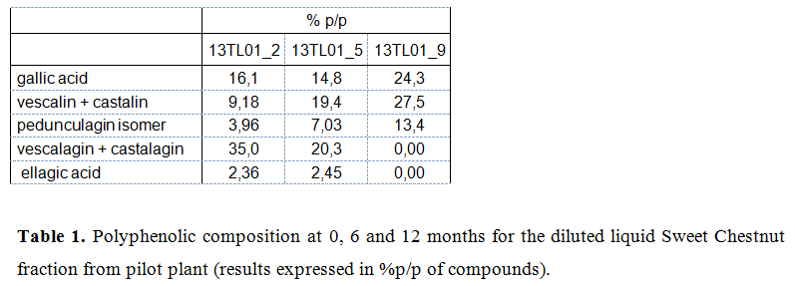
LIFE13 ENV/IT/000461 – EVERGREEN
24th month Meeting
2016, September 23rd
Mondo Verde srl
Action B3
1st January 2015 - 31st December 2015

Slide 37
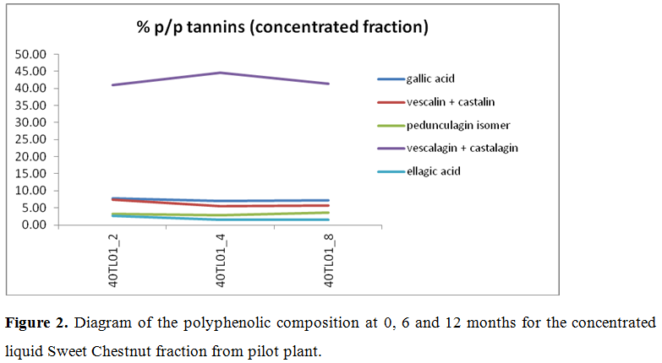
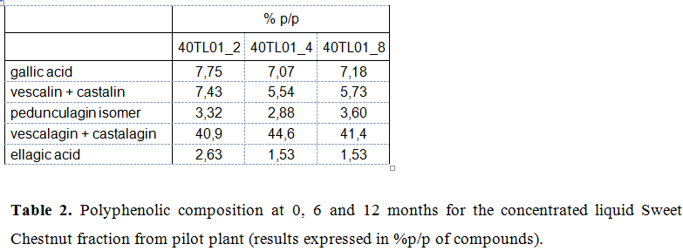
LIFE13 ENV/IT/000461 – EVERGREEN
24th month Meeting
2016, September 23rd
Mondo Verde srl
Action B3
1st January 2015 - 31st December 2015

Slide 38
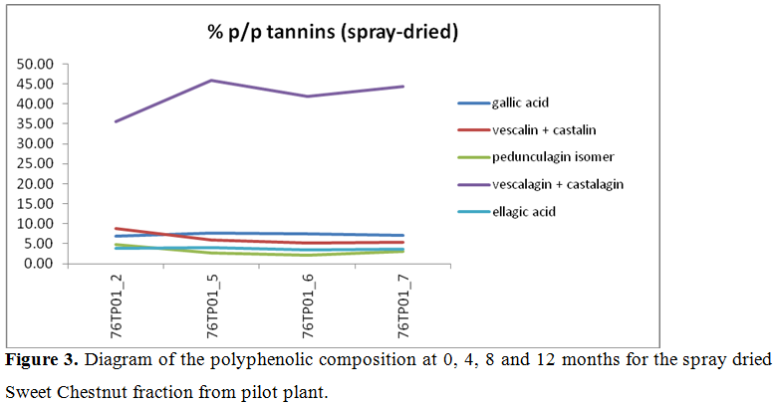
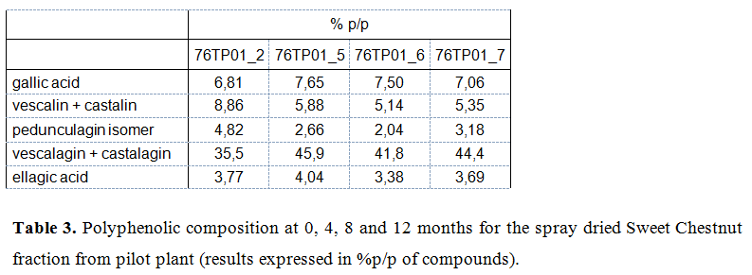
LIFE13 ENV/IT/000461 – EVERGREEN
24th month Meeting
2016, September 23rd
Mondo Verde srl
Action B3
1st January 2015 - 31st December 2015

Slide 39
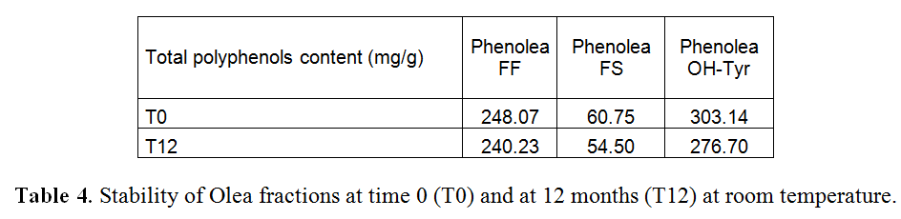
LIFE13 ENV/IT/000461 – EVERGREEN
24th month Meeting
2016, September 23rd
Mondo Verde srl
Action B3
1st January 2015 - 31st December 2015

Slide 40
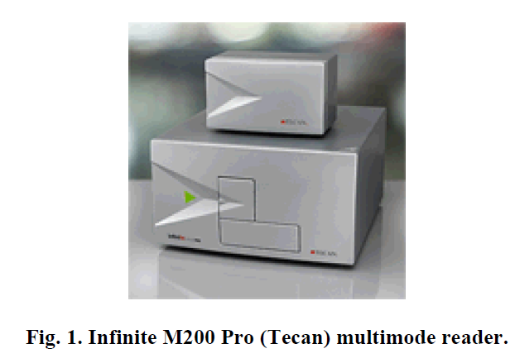
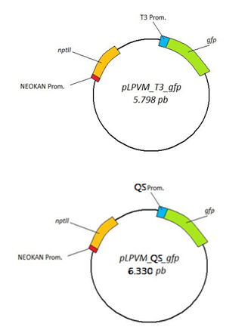
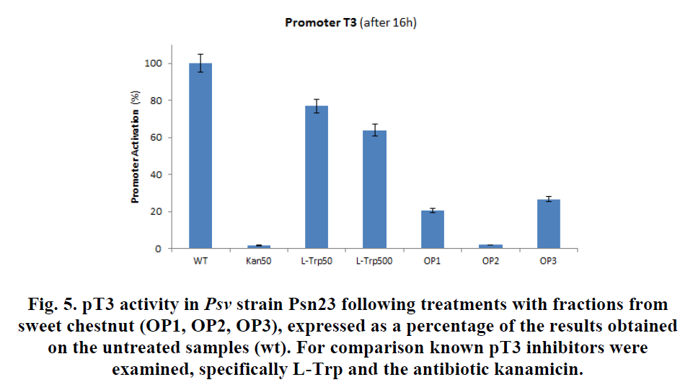
LIFE13 ENV/IT/000461 – EVERGREEN
24th month Meeting
2016, September 23rd
Mondo Verde srl

Slide 41
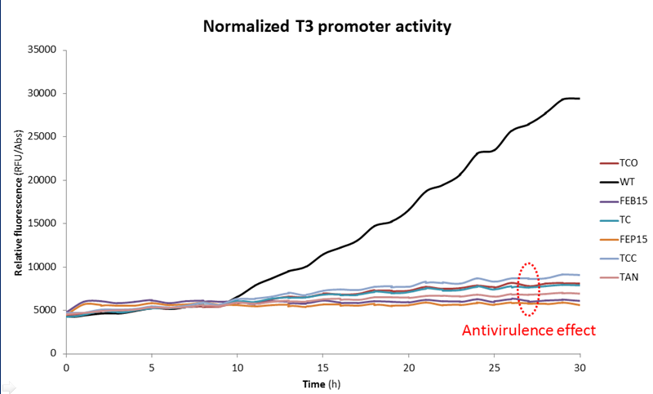
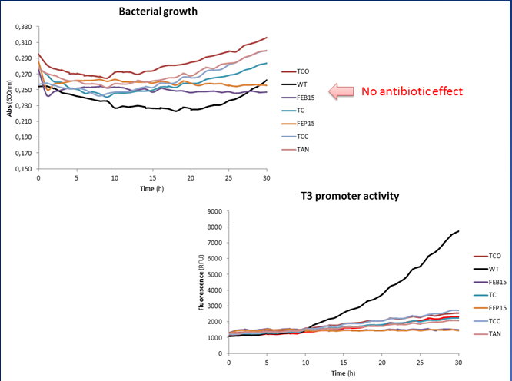
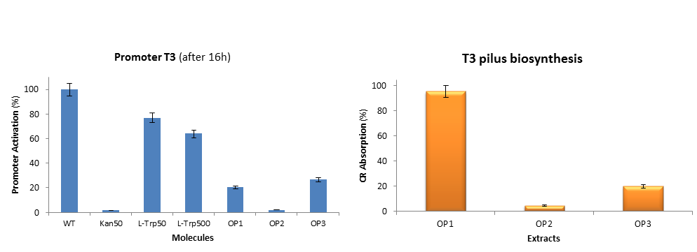
LIFE13 ENV/IT/000461 – EVERGREEN
24th month Meeting
2016, September 23rd
Mondo Verde srl
Action B3
1st January 2015 - 31st December 2015

Slide 42
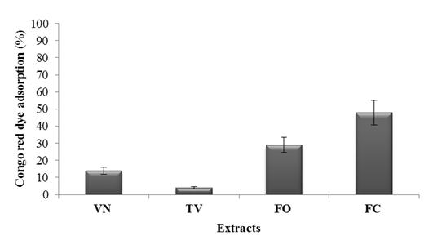
LIFE13 ENV/IT/000461 – EVERGREEN
24th month Meeting
2016, September 23rd
Mondo Verde srl
Action B3
1st January 2015 - 31st December 2015
Biancalani et al., 2016
PLoS ONE
(in press)

Slide 43
LIFE13 ENV/IT/000461 – EVERGREEN
24th month Meeting
2016, September 23rd
Mondo Verde srl
Action B4
1st April 2015 - 31st December 2015
Demonstration of the biological activity of
the high quality polyphenolic extracts recovered from not edible biomass and waste, against plant
pathogenic bacteria and nematode, in planta

Slide 44

LIFE13 ENV/IT/000461 – EVERGREEN
24th month Meeting
2016, September 23rd
Mondo Verde srl
Action B4
1st April 2015 - 31st December 2015
HR inhibition on Tobacco challenged by Pseudomonas savastanoi
Biancalani et al., 2016 – PLoS ONE (in press)

Slide 45

LIFE13 ENV/IT/000461 – EVERGREEN
24th month Meeting
2016, September 23rd
Mondo Verde srl
Action B4
1st April 2015 - 31st December 2015

Slide 46

LIFE13 ENV/IT/000461 – EVERGREEN
24th month Meeting
2016, September 23rd
Mondo Verde srl
Action B4
1st April 2015 - 31st December 2015
Biancalani et al., 2016 – PLoS ONE (in press)

Slide 47

LIFE13 ENV/IT/000461 – EVERGREEN
24th month Meeting
2016, September 23rd
Mondo Verde srl
Action B4
1st April 2015 - 31st December 2015

Slide 48

LIFE13 ENV/IT/000461 – EVERGREEN
24th month Meeting
2016, September 23rd
Mondo Verde srl
Action B4
1st April 2015 - 31st December 2015

Slide 49

LIFE13 ENV/IT/000461 – EVERGREEN
24th month Meeting
2016, September 23rd
Mondo Verde srl
Action B4
1st April 2015 - 31st December 2015

Slide 50
LIFE13 ENV/IT/000461 – EVERGREEN
24th month Meeting
2016, September 23rd
Mondo Verde srl
Action B5
1st July 2015 - 31st March 2016
Demonstration of Kilo-scale extraction of
the high quality polyphenolic bioactive molecules recovered from vegetable not edible
biomass and waste

Slide 51


LIFE13 ENV/IT/000461 – EVERGREEN
24th month Meeting
2016, September 23rd
Mondo Verde srl
Action B5
1st July 2015 - 31st March 2016
Polyfunctional platform for the production of antioxidant extracts and biogas from byproducts of Olea europaea L.

Slide 52

LIFE13 ENV/IT/000461 – EVERGREEN
24th month Meeting
2016, September 23rd
Mondo Verde srl
Action B5
1st July 2015 - 31st March 2016

Slide 53
LIFE13 ENV/IT/000461 – EVERGREEN
24th month Meeting
2016, September 23rd
Mondo Verde srl
Action B5
1st July 2015 - 31st March 2016
OTHER PLANTS…
pictures etc

Slide 54
LIFE13 ENV/IT/000461 – EVERGREEN
24th month Meeting
2016, September 23rd
Mondo Verde srl
Action B6
1st April 2015 - 31st March 2016
Demonstration of the null toxicity profile of the high quality polyphenolic bioactive molecules recovered from vegetable not edible biomass and
waste, on model organisms and microorganisms

Slide 55


LIFE13 ENV/IT/000461 – EVERGREEN
24th month Meeting
2016, September 23rd
Mondo Verde srl
Action B6
1st April 2015 - 31st March 2016
Genus Artemia in ecotoxicity testing
Environmental Pollution 144 (2006) 453-462
Test No. 202: Daphnia magna
Acute Immobilization Test
OECD Guidelines for the Testing of Chemicals
Retrieved July 4, 2013

Slide 56

LIFE13 ENV/IT/000461 – EVERGREEN
24th month Meeting
2016, September 23rd
Mondo Verde srl
Action B6
1st April 2015 - 31st March 2016

Slide 57

LIFE13 ENV/IT/000461 – EVERGREEN
24th month Meeting
2016, September 23rd
Mondo Verde srl
Action B6
1st April 2015 - 31st March 2016

Slide 58

LIFE13 ENV/IT/000461 – EVERGREEN
24th month Meeting
2016, September 23rd
Mondo Verde srl
Action B6
1st April 2015 - 31st March 2016

Slide 59


LIFE13 ENV/IT/000461 – EVERGREEN
24th month Meeting
2016, September 23rd
Mondo Verde srl
Action B6
1st April 2015 - 31st March 2016

Slide 60
LIFE13 ENV/IT/000461 – EVERGREEN
24th month Meeting
2016, September 23rd
Mondo Verde srl
Action B7
1st July 2015 – 30th September 2016
Demonstration of the in vivo performances of the high quality polyphenolic bioactive preparations, recovered from vegetable not edible biomass and
waste,at pilot scale level in field screenings

Slide 61

LIFE13 ENV/IT/000461 – EVERGREEN
24th month Meeting
2016, September 23rd
Mondo Verde srl
Action B7
1st July 2015 – 30th September 2016

Slide 62
LIFE13 ENV/IT/000461 – EVERGREEN
24th month Meeting
2016, September 23rd
Mondo Verde srl
Action B7
1st July 2015 – 30th September 2016

Slide 63

LIFE13 ENV/IT/000461 – EVERGREEN
24th month Meeting
2016, September 23rd
Mondo Verde srl
Action B7
1st July 2015 – 30th September 2016

Slide 64



LIFE13 ENV/IT/000461 – EVERGREEN
24th month Meeting
2016, September 23rd
Mondo Verde srl
Action B7
1st July 2015 – 30th September 2016

Slide 65
LIFE13 ENV/IT/000461 – EVERGREEN
24th month Meeting
2016, September 23rd
Mondo Verde srl
Action C1
1st October 2014 - 31st March 2015
Monitoring on the environmental impact of
copper compounds and nematicides for the crop defence against phytopathogenic
bacteria and nematodes

Slide 66

LIFE13 ENV/IT/000461 – EVERGREEN
24th month Meeting
2016, September 23rd
Mondo Verde srl
Action C1
1st October 2014 - 31st March 2015

Slide 67

LIFE13 ENV/IT/000461 – EVERGREEN
24th month Meeting
2016, September 23rd
Mondo Verde srl
Action C1
1st October 2014 - 31st March 2015

Slide 68
LIFE13 ENV/IT/000461 – EVERGREEN
24th month Meeting
2016, September 23rd
Mondo Verde srl
Action C2
1st January 2015 - 31st December 2015
Monitoring of the absence of side effects for the high quality standardised polyphenolic preparations on common targets
of any living organism at laboratory level

Slide 69

LIFE13 ENV/IT/000461 – EVERGREEN
24th month Meeting
2016, September 23rd
Mondo Verde srl
Action C2
1st January 2015 - 31st December 2015

Slide 70

LIFE13 ENV/IT/000461 – EVERGREEN
24th month Meeting
2016, September 23rd
Mondo Verde srl
Action C2
1st January 2015 - 31st December 2015
Biancalani et al., 2016 – PLoS ONE (in press)

Slide 71

LIFE13 ENV/IT/000461 – EVERGREEN
24th month Meeting
2016, September 23rd
Mondo Verde srl
Action C2
1st January 2015 - 31st December 2015

Slide 72
LIFE13 ENV/IT/000461 – EVERGREEN
24th month Meeting
2016, September 23rd
Mondo Verde srl
Action C3
1st April 2015 - 31st March 2016
Monitoring of the absence of a direct selection operated by the polyphenolic preparations
towards the emergence of bacteria resistant to the polyphenolic molecules themselves,
at laboratory level

Slide 73

LIFE13 ENV/IT/000461 – EVERGREEN
24th month Meeting
2016, September 23rd
Mondo Verde srl
Action C3
1st April 2015 - 31st March 2016

Slide 74

LIFE13 ENV/IT/000461 – EVERGREEN
24th month Meeting
2016, September 23rd
Mondo Verde srl
Action C3
1st April 2015 - 31st March 2016
Biancalani et al., 2016 – PLoS ONE (in press)

Slide 75


LIFE13 ENV/IT/000461 – EVERGREEN
24th month Meeting
2016, September 23rd
Mondo Verde srl
Action C3
1st April 2015 - 31st March 2016
Verified at 20, 60 and 80 generation treated

Slide 76
LIFE13 ENV/IT/000461 – EVERGREEN
24th month Meeting
2016, September 23rd
Mondo Verde srl
Action C4
1st July 2015 – 30th September 2016
Monitoring of the short term environmental benefits from the use of the high quality standardised polyphenolic preparations
in plant disease control
at pilot scale level in field screenings

Slide 77


LIFE13 ENV/IT/000461 – EVERGREEN
24th month Meeting
2016, September 23rd
Mondo Verde srl
Action C4
1st July 2015 – 30th September 2016

Slide 78

LIFE13 ENV/IT/000461 – EVERGREEN
24th month Meeting
2016, September 23rd
Mondo Verde srl
Action C4
1st July 2015 – 30th September 2016

Slide 79
LIFE13 ENV/IT/000461 – EVERGREEN
24th month Meeting
2016, September 23rd
Mondo Verde srl
Action C5
1st April 2015 – 30th September 2016
Monitoring of the economic benefits deriving from the recycling of the spent vegetable biomass
after the extraction of the high quality standardised polyphenolic molecules
at laboratory level

Slide 80


LIFE13 ENV/IT/000461 – EVERGREEN
24th month Meeting
2016, September 23rd
Mondo Verde srl
Action C5
1st April 2015 – 30th September 2016
PCT/IT2009000246, filing date 05/06/09,A.
Romani; D. Pangia; G. Marchinni. “Integrated process for recovery of a polyphenol fraction and anaerobic
digestion of olive mill wastes”;
PCT/IT2008/000135, filing date 01/04/08. Pizzichini M., Romani A., Pizzichini D.,
Russo C., Pinelli P. “Process for producing refined nutraceutic extracts from artichoke waste and from other
plants of the Cynara genus”
“This demonstration is delegated to INSTM and Mondo Verde”

Slide 81
LIFE13 ENV/IT/000461 – EVERGREEN
24th month Meeting
2016, September 23rd
Mondo Verde srl
Action C6
1st July 2015 – 30th September 2016
Monitoring of the absence of a selection on the polyphenolic preparations on
copper and antibiotic resistant bacteria,
on plant and in soil,
from laboratory to in field screenings

Slide 82


LIFE13 ENV/IT/000461 – EVERGREEN
24th month Meeting
2016, September 23rd
Mondo Verde srl
Action C6
1st July 2015 – 30th September 2016

Slide 83
LIFE13 ENV/IT/000461 – EVERGREEN
24th month Meeting
2016, September 23rd
Mondo Verde srl
Action C7
1st April 2015 – 30th September 2016
Monitoring of technical-socio-economic assessment of the EVERGREEN project

Slide 84

LIFE13 ENV/IT/000461 – EVERGREEN
24th month Meeting
2016, September 23rd
Mondo Verde srl
Action C7
1st April 2015 – 30th September 2016

Slide 85

LIFE13 ENV/IT/000461 – EVERGREEN
24th month Meeting
2016, September 23rd
Mondo Verde srl
Action C7
1st April 2015 – 30th September 2016

Slide 86

LIFE13 ENV/IT/000461 – EVERGREEN
24th month Meeting
2016, September 23rd
Mondo Verde srl
Action C7
1st April 2015 – 30th September 2016
“DISPAA, CEBAS, and ASTRA will be involved in…”
DATA FROM ALL BENEFICIARIES HAVE TO BE FREELY AVAILABLE
for analysis and evaluation

Slide 87

LIFE13 ENV/IT/000461 – EVERGREEN
24th month Meeting
2016, September 23rd
Mondo Verde srl
Action C7
1st April 2015 – 30th September 2016
BENEFICIARIES HAVE TO BE in strict contact with
CARBON SINK
Which is in charge for analysis and evaluation
(next appointment 28th Sept 2016 – LPVM)

Slide 88
LIFE13 ENV/IT/000461 – EVERGREEN
24th month Meeting
2016, September 23rd
Mondo Verde srl
TECHNICAL ACTIVITIES CARRIED OUT
B. Implementation actions
B2 Demonstration of the qualitative and quantitative yields of extraction process for the recovery of high quality polyphenolic molecules from not edible vegetable biomass and waste at laboratory scale
B3 Demonstration of the biological and of the chemical stability of the crude polyphenolic extracts and of their fractions, recovered from not edible vegetable biomass and waste, at laboratory scale
B4 Demonstration of the biological activity of the high quality polyphenolic extracts recovered from not edible biomass and waste, against plant pathogenic bacteria and nematode, in planta
B5 Demonstration of Kilo-scale extraction of the high quality poly-phenolic bioactive molecules recovered from vegetable not edible biomass and waste
B6 Demonstration of the null toxicity profile of the high quality poly-phenolic bioactive molecules recovered from vegetable not edible biomass and waste, on model organisms and microorganisms.

Slide 89
LIFE13 ENV/IT/000461 – EVERGREEN
24th month Meeting
2016, September 23rd
Mondo Verde srl
TECHNICAL ACTIVITIES CARRIED OUT
C. Monitoring of the impact of the project actions
C2 Monitoring of the absence of side effects for the high quality standardised polyphenolic preparations on common targets of any living organism at laboratory level
C3 Monitoring of the absence of a direct selection operated by the polyphenolic preparations towards the emergence of bacteria resistant to the polyphenolic molecules themselves, at laboratory level
C6 Monitoring of the absence of a selection on the polyphenolic preparations on the selection of copper and antibiotic resistant bacteria, on plant and in soil, from laboratory to in field screenings.

Slide 90

LIFE13 ENV/IT/000461 – EVERGREEN
24th month Meeting
2016, September 23rd
Mondo Verde srl

Slide 91

LIFE13 ENV/IT/000461 – EVERGREEN
24th month Meeting
2016, September 23rd
Mondo Verde srl
WRITING TIME!!!
Just as a memory..

Slide 92
LIFE13 ENV/IT/000461 – EVERGREEN
24th month Meeting
2016, September 23rd
Mondo Verde srl
WRITING TIME!!!
Just as a memory..
- Layman’s Report
- EVERGREEN Manual

Slide 93

LIFE13 ENV/IT/000461 – EVERGREEN
24th month Meeting
2016, September 23rd
Mondo Verde srl
Just as a memory..
- Layman’s Report

Slide 94

LIFE13 ENV/IT/000461 – EVERGREEN
24th month Meeting
2016, September 23rd
Mondo Verde srl
Just as a memory..
- EVERGREEN Manual

Slide 95

LIFE13 ENV/IT/000461 – EVERGREEN
24th month Meeting
2016, September 23rd
Mondo Verde srl
www.unifi.it

Slide 96





LIFE13 ENV/IT/000461 – EVERGREEN
24th month Meeting
2016, September 23rd
Mondo Verde srl
www.unifi.it

Slide 97
LIFE13 ENV/IT/000461 – EVERGREEN
24th month Meeting
2016, September 23rd
Mondo Verde srl
And now,
associated beneficiaries
and then
Dissemination and
Financial issues
Dr. Silvia Borselli
Dr. Costantino Raspi

Slide 98
LIFE13 ENV/IT/000461 – EVERGREEN
24th month Meeting
2016, September 23rd
Mondo Verde srl

Slide 99
LIFE13 ENV/IT/000461 – EVERGREEN
24th month Meeting
2016, September 23rd
Mondo Verde srl

