Slide 1



Project LIFE13 ENV/IT/000461
“Environmentally friendly biomolecules from agricultural wastes as substitutes
of pesticides for plant diseases control”
“EVERGREEN”
Start: 01/10/2014
End: 31/09/2016
EVERGREEN Monitoring visit and 6th month Meeting – 2015, April 28th
Molecular Plant Pathology Lab – DISPAA – University of Florence,
Polo Scientifico e Tecnologico, Sesto Fiorentino (Florence)

Slide 2
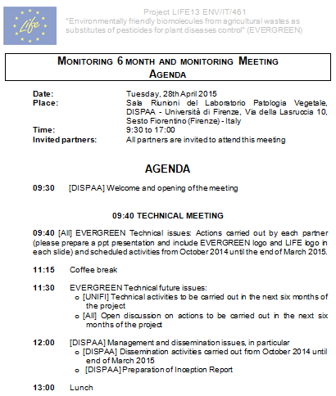

Slide 3

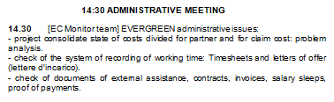


Slide 4
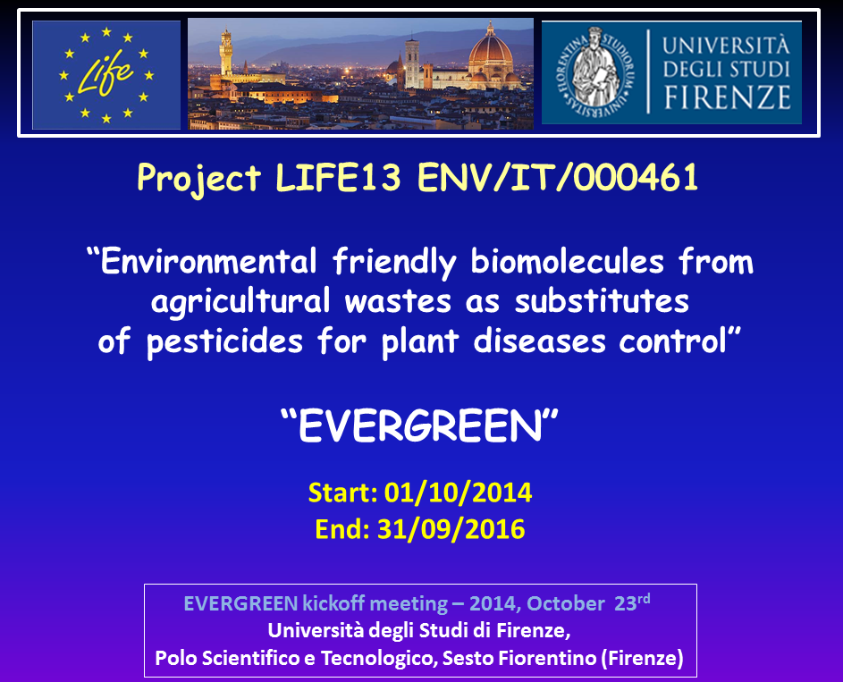

Slide 5



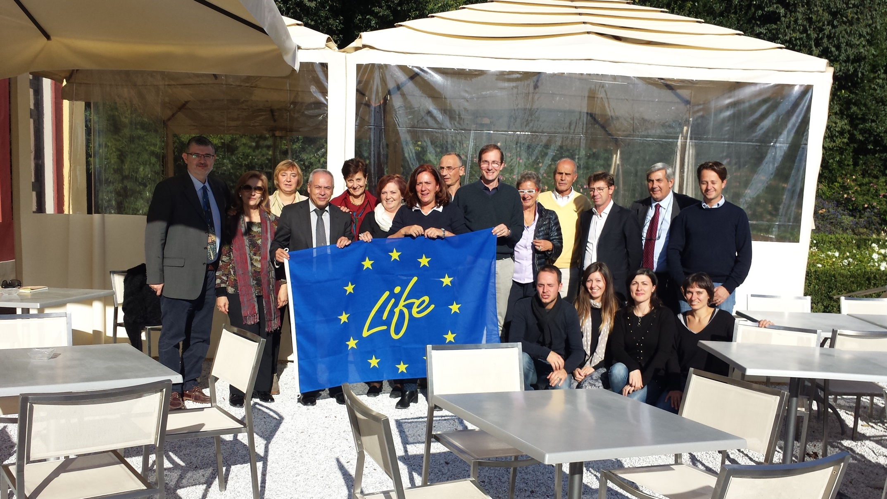

Slide 6
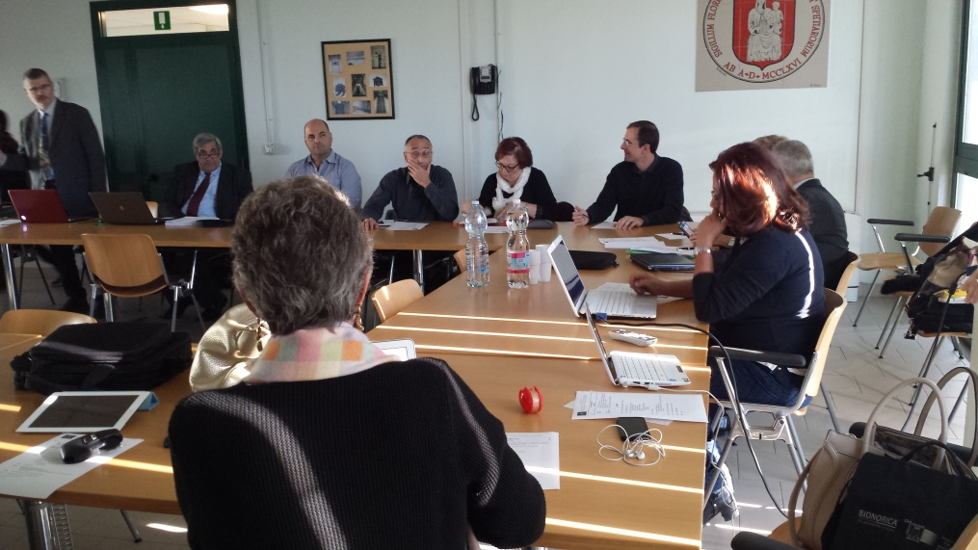
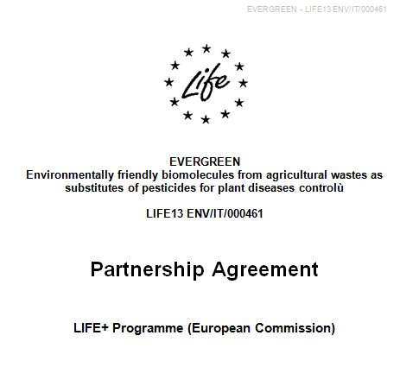

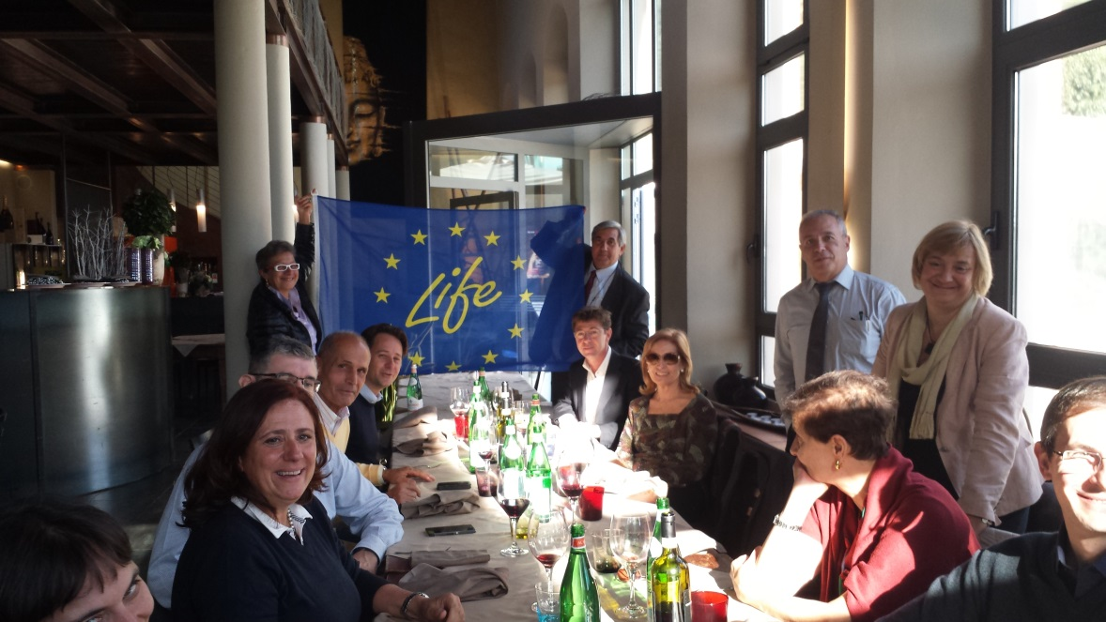

Slide 7
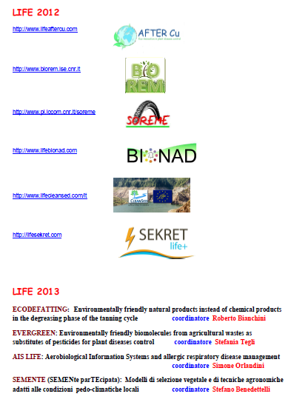
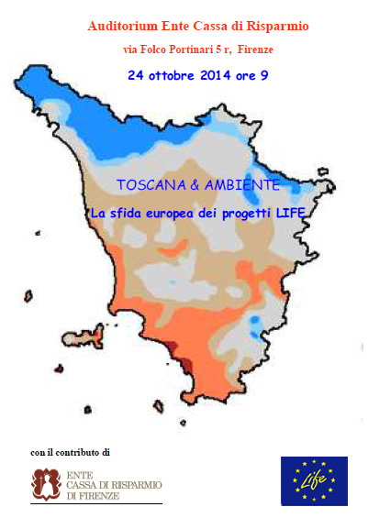
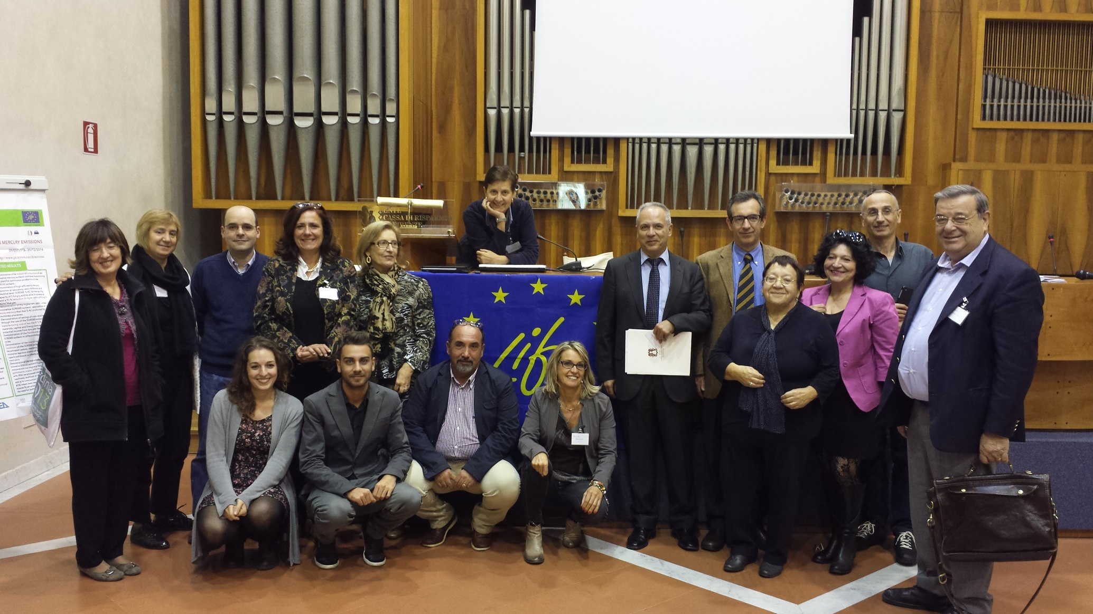
LIFE13 ENV/IT/000461 – EVERGREEN
Monitoring visit and 6th month Meeting – 2015, April 28th
DISPAA, University of Florence

Slide 8
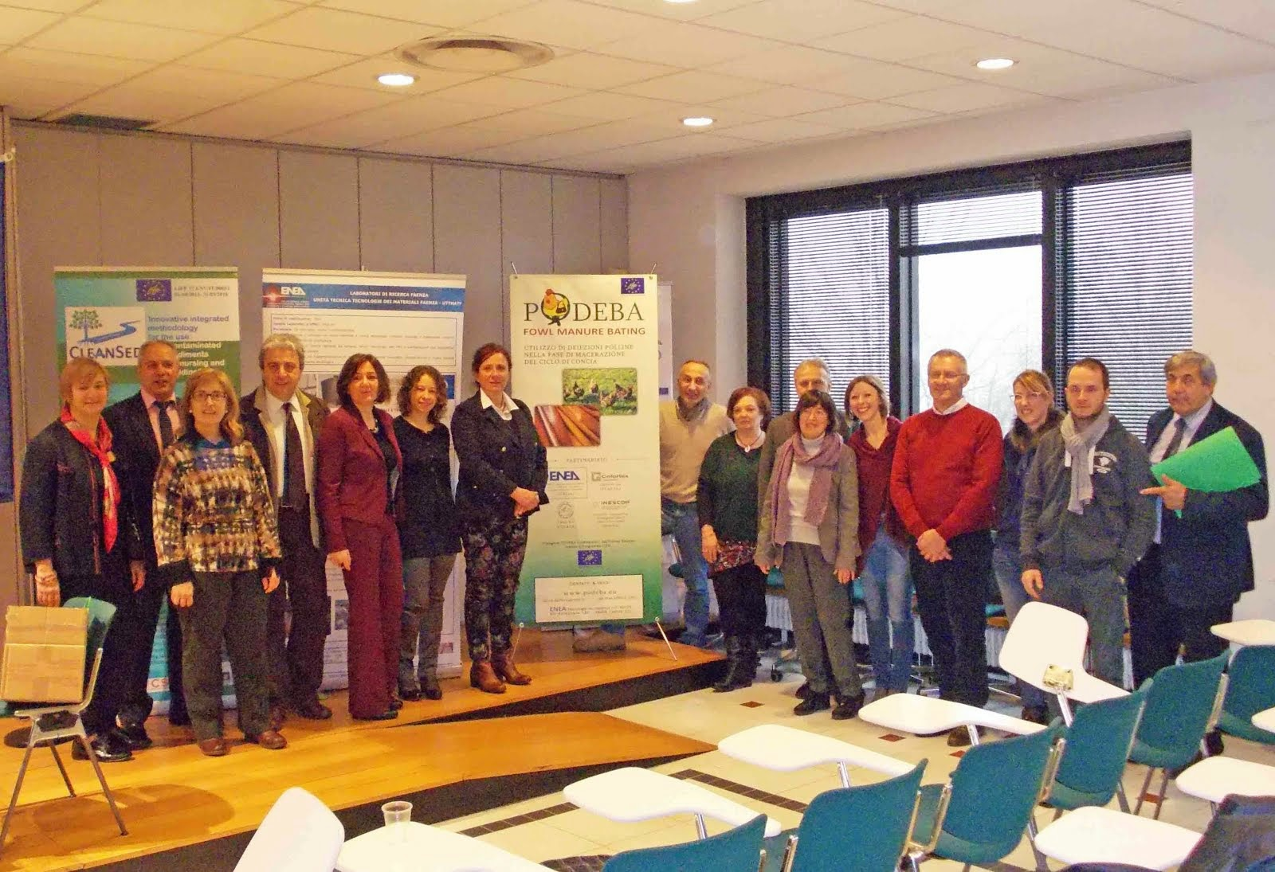

LIFE13 ENV/IT/000461 – EVERGREEN
Monitoring visit and 6th month Meeting – 2015, April 28th
DISPAA, University of Florence

Slide 9

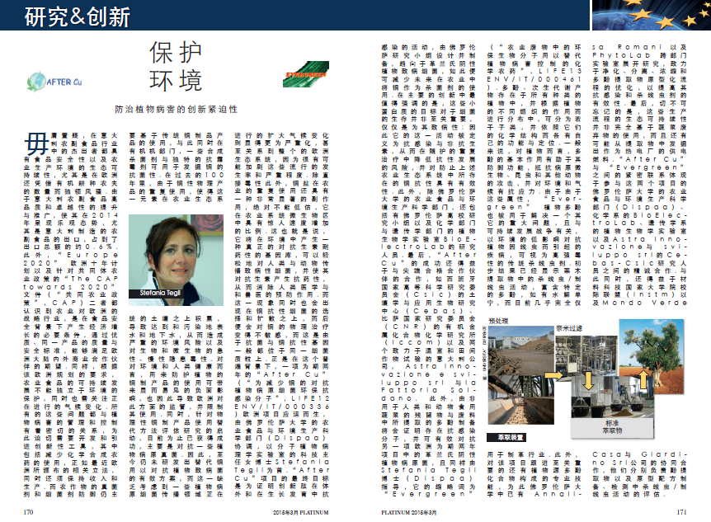
LIFE13 ENV/IT/000461 – EVERGREEN
Monitoring visit and 6th month Meeting – 2015, April 28th
DISPAA, University of Florence

Slide 10
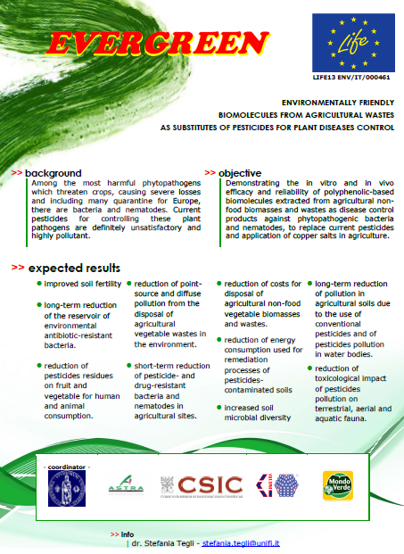
LIFE13 ENV/IT/000461 – EVERGREEN
Monitoring visit and 6th month Meeting – 2015, April 28th
DISPAA, University of Florence

Slide 11
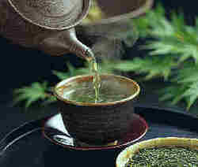
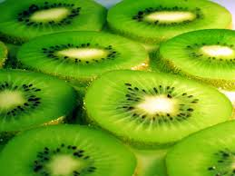

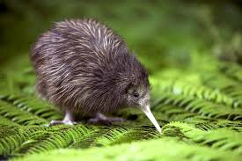
LIFE13 ENV/IT/000461 – EVERGREEN
Monitoring visit and 6th month Meeting – 2015, April 28th
DISPAA, University of Florence
Project LIFE13 ENV/IT/000461
“EVERGREEN”
When actually did
the EVERGREEN story start?

Slide 12
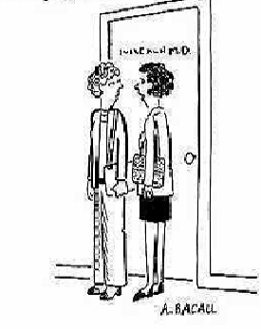

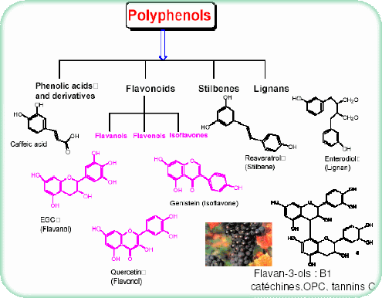
LIFE13 ENV/IT/000461 – EVERGREEN
Monitoring visit and 6th month Meeting – 2015, April 28th
DISPAA, University of Florence
A storm in a tea cup!!!
I am not so confident in this doctor:
did you notice that all his plants look sick?
or in a bottle of wine!!!

Slide 13

LIFE13 ENV/IT/000461 – EVERGREEN
Monitoring visit and 6th month Meeting – 2015, April 28th
DISPAA, University of Florence

Slide 14
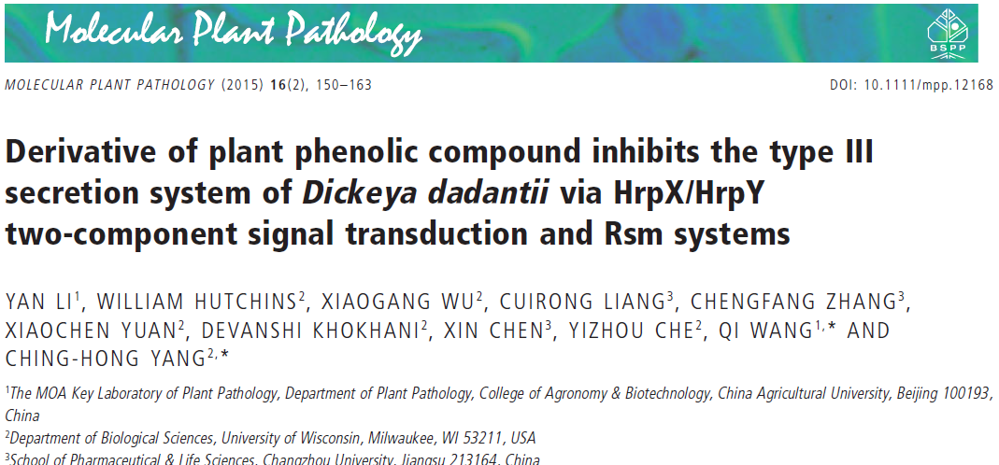
LIFE13 ENV/IT/000461 – EVERGREEN
Monitoring visit and 6th month Meeting – 2015, April 28th
DISPAA, University of Florence

Slide 15
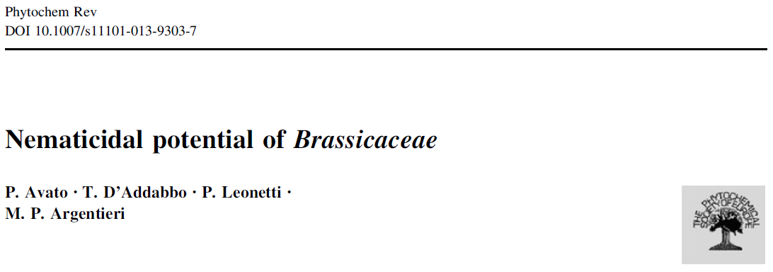
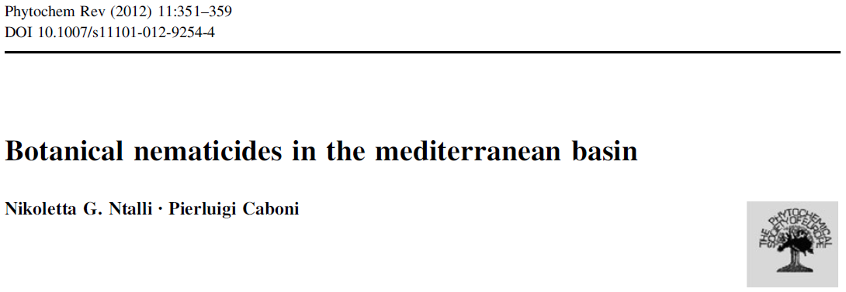
LIFE13 ENV/IT/000461 – EVERGREEN
Monitoring visit and 6th month Meeting – 2015, April 28th
DISPAA, University of Florence

Slide 16
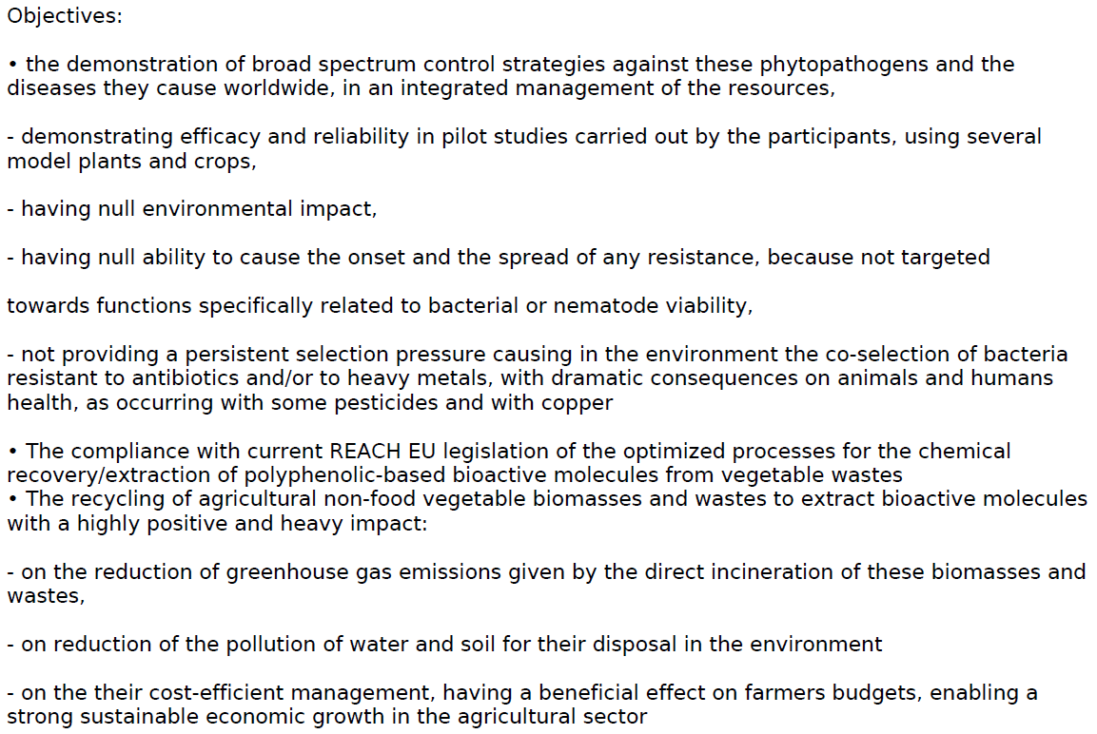
LIFE13 ENV/IT/000461 – EVERGREEN
Monitoring visit and 6th month Meeting – 2015, April 28th
DISPAA, University of Florence
√
√
√
√
√
√
√
√
√
√

Slide 17

LIFE13 ENV/IT/000461 – EVERGREEN
Monitoring visit and 6th month Meeting – 2015, April 28th
DISPAA, University of Florence
B. Implementation actions
B1 Demonstration of the performances of traditional pesticides for the control of bacterial and nematode diseases of plants important for the EU
B2 Demonstration of the qualitative and quantitative yields of extraction process for the recovery of high quality polyphenolic molecules from not edible vegetable biomass and waste at laboratory scale
B3 Demonstration of the biological and of the chemical stability of the crude polyphenolic extracts and of their fractions, recovered from not edible vegetable biomass and waste, at laboratory scale
B4 Demonstration of the biological activity of the high quality polyphenolic extracts recovered from not edible biomass and waste, against plant pathogenic bacteria and nematode, in planta

Slide 18
LIFE13 ENV/IT/000461 – EVERGREEN
Monitoring visit and 6th month Meeting – 2015, April 28th
DISPAA, University of Florence
B. Implementation actions
B5 Demonstration of Kilo-scale extraction of the high quality poly-phenolic bioactive molecules recovered from vegetable not edible biomass and waste
B6 Demonstration of the null toxicity profile of the high quality poly-phenolic bioactive molecules recovered from vegetable not edible biomass and waste, on model organisms and microorganisms.
B7 Demonstration of the in vivo performances of the high quality poly-phenolic bioactive preparations, recovered from vegetable not edible biomass and waste,at pilot scale level in field screenings.

Slide 19
LIFE13 ENV/IT/000461 – EVERGREEN
Monitoring visit and 6th month Meeting – 2015, April 28th
DISPAA, University of Florence
C. Monitoring of the impact of the project actions
C1 Monitoring on the environmental impact of copper compounds and nematicides for the crop defense against phytopathogenic bacteria and nematodes
C2 Monitoring of the absence of side effects for the high quality standardised polyphenolic preparations on common targets of any living organism at laboratory level
C3 Monitoring of the absence of a direct selection operated by the polyphenolic preparations towards the emergence of bacteria resistant to the polyphenolic molecules themselves, at laboratory level
C4 Monitoring of the short term environmental benefits from the use of the high quality standardised polyphenolic preparations in plant disease control at pilot scale level in field screenings

Slide 20
LIFE13 ENV/IT/000461 – EVERGREEN
Monitoring visit and 6th month Meeting – 2015, April 28th
DISPAA, University of Florence
C. Monitoring of the impact of the project actions
C5 Monitoring of the economic benefits deriving from the recycling of the spent vegetable biomass after the extraction of the high quality standardised polyphenolic molecules at laboratory level
C6 Monitoring of the absence of a selection on the polyphenolic preparations on the selection of copper and antibiotic resistant bacteria, on plant and in soil, from laboratory to in field screenings.
C7 Monitoring of technical-socio-economic assessment of the EVERGREEN project

Slide 21
LIFE13 ENV/IT/000461 – EVERGREEN
Monitoring visit and 6th month Meeting – 2015, April 28th
DISPAA, University of Florence
D. Communication and dissemination actions
D1 Website creation
D2 Notice boards
D3 Demonstration workshops in Italy
D4 Demonstration workshops in Spain
D5 Diffusion material preparation
D6 Layman’s report
D7 Articles and press releases
D8 Networking
D9 Technical manual
D10 International conferences and fairs
D11 Dissemination to institutions and policy makers
D12 After-LIFE communication plan
D13 Digital supports for international diffusion

Slide 22
LIFE13 ENV/IT/000461 – EVERGREEN
Monitoring visit and 6th month Meeting – 2015, April 28th
DISPAA, University of Florence
E. Project management and monitoring of the project progress
E1 Project management
E2 Monitoring
E3 Audit

Slide 23
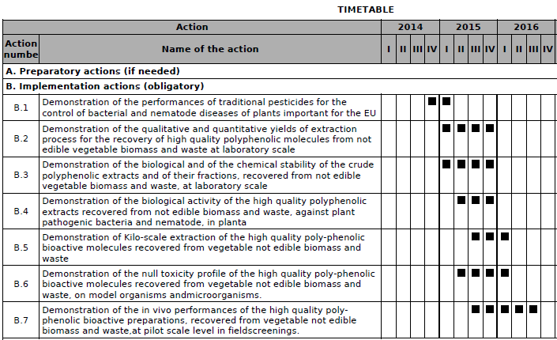
LIFE13 ENV/IT/000461 – EVERGREEN
Monitoring visit and 6th month Meeting – 2015, April 28th
DISPAA, University of Florence

Slide 24
LIFE13 ENV/IT/000461 – EVERGREEN
Monitoring visit and 6th month Meeting – 2015, April 28th
DISPAA, University of Florence

Slide 25

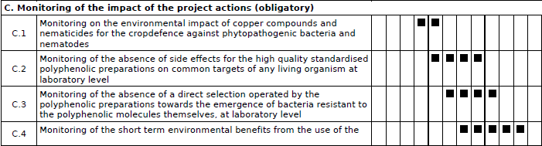
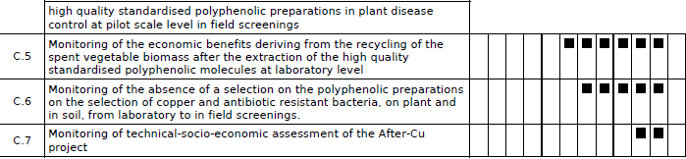
LIFE13 ENV/IT/000461 – EVERGREEN
Monitoring visit and 6th month Meeting – 2015, April 28th
DISPAA, University of Florence

Slide 26
LIFE13 ENV/IT/000461 – EVERGREEN
Monitoring visit and 6th month Meeting – 2015, April 28th
DISPAA, University of Florence

Slide 27

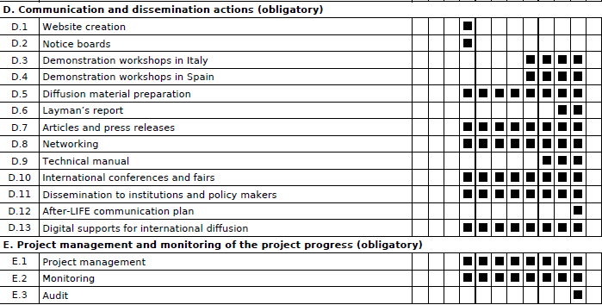
LIFE13 ENV/IT/000461 – EVERGREEN
Monitoring visit and 6th month Meeting – 2015, April 28th
DISPAA, University of Florence

Slide 28
LIFE13 ENV/IT/000461 – EVERGREEN
Monitoring visit and 6th month Meeting – 2015, April 28th
DISPAA, University of Florence

Slide 29

LIFE13 ENV/IT/000461 – EVERGREEN
Monitoring visit and 6th month Meeting – 2015, April 28th
DISPAA, University of Florence
skills, expertise, technological advanced instruments
• Chemistry platform
• Molecular biology platform
• Microbiological platform
• In planta screening platform

Slide 30





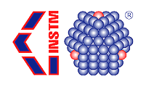

Slide 31
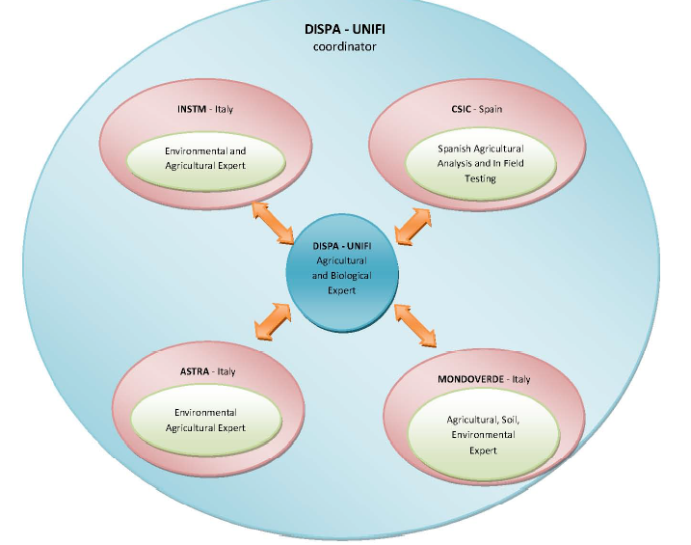
LIFE13 ENV/IT/000461 – EVERGREEN
Monitoring visit and 6th month Meeting – 2015, April 28th
DISPAA, University of Florence
B1, B2, B3, B4, B5, B7
B1, B2, B3, B4, B5, B6, B7
(B4) B7
(B4) B7

Slide 32
LIFE13 ENV/IT/000461 – EVERGREEN
Monitoring visit and 6th month Meeting – 2015, April 28th
DISPAA, University of Florence
C1, C5
C1, C2, C3, C4, C6, C7
(C1) C7
C1, C5

Slide 33
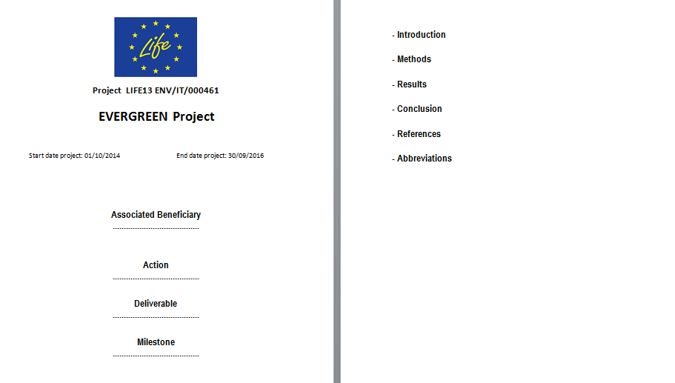
LIFE13 ENV/IT/000461 – EVERGREEN
Monitoring visit and 6th month Meeting – 2015, April 28th
DISPAA, University of Florence
EVERGREEN form for Periodical reports

Slide 34
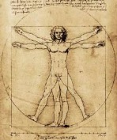
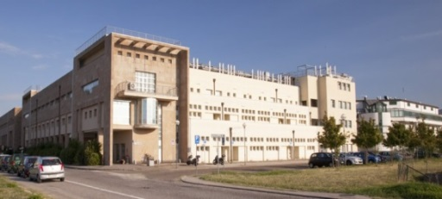
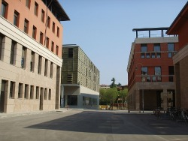
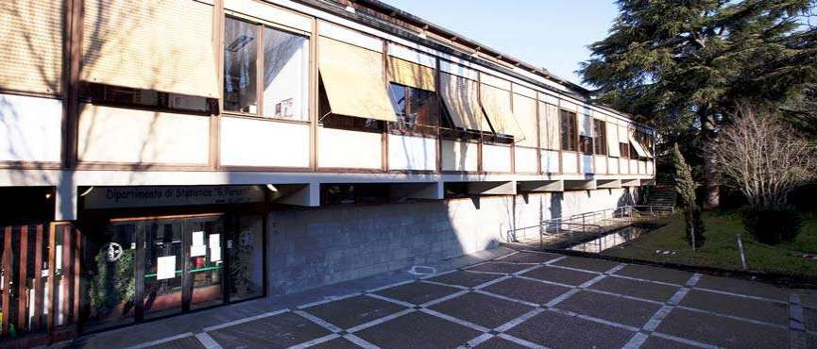
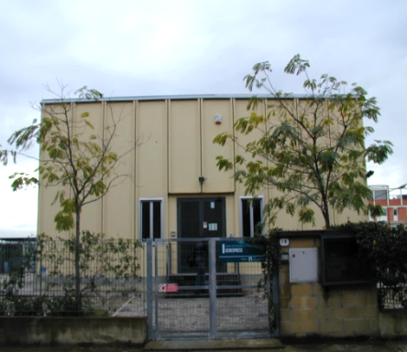
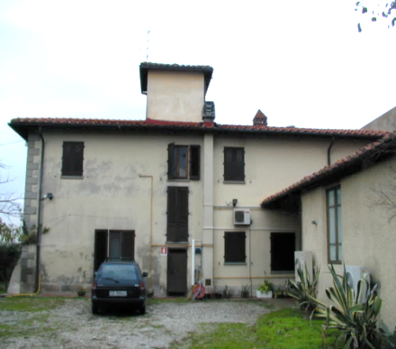
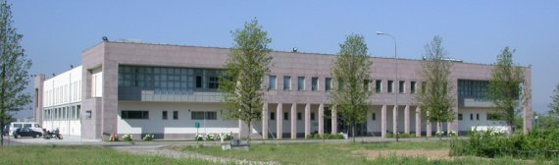
LIFE13 ENV/IT/000461 – EVERGREEN
Monitoring visit and 6th month Meeting – 2015, April 28th
DISPAA, University of Florence
Coordinating beneficiary research units
Dept. of Chemistry
Dept. of Biology
Dept. of Statistics
Dept. of Agrifood Production and Environmental Sciences
Genexpress
Arboriculture
Molecular Plant Pathology

Slide 35
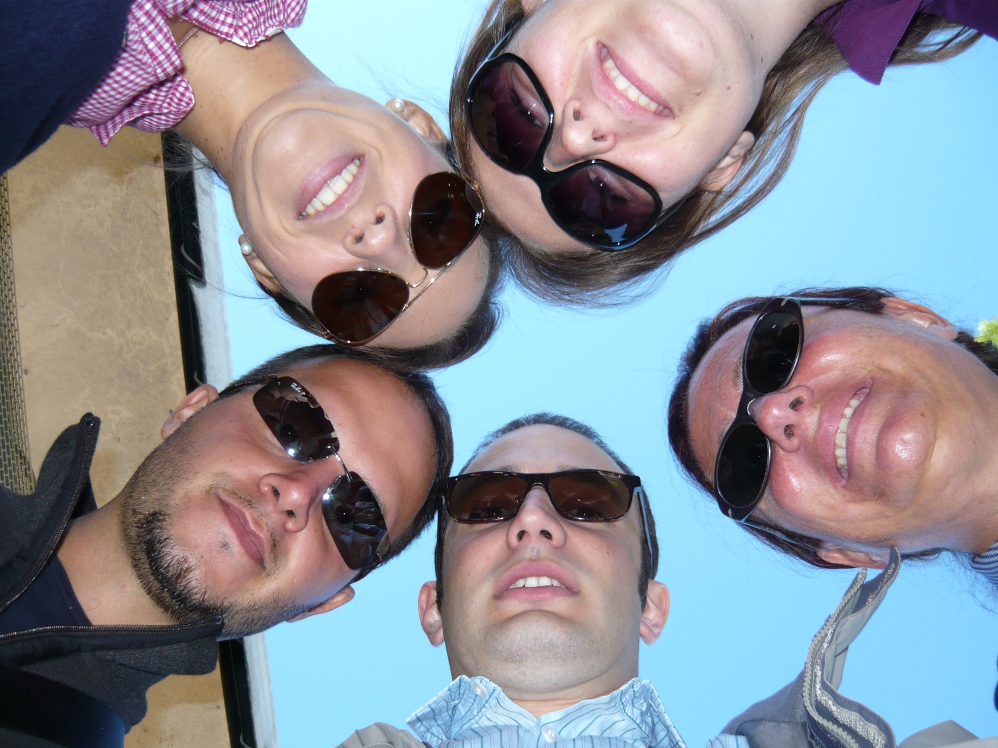
LIFE13 ENV/IT/000461 – EVERGREEN
Monitoring visit and 6th month Meeting – 2015, April 28th
DISPAA, University of Florence
Coordinating beneficiary research units

Slide 36
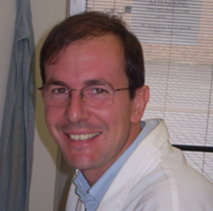

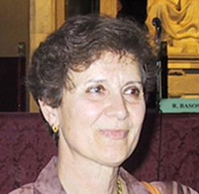
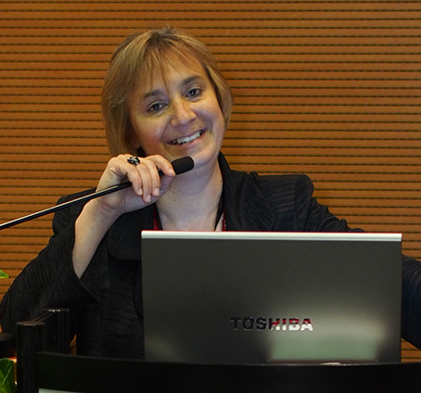
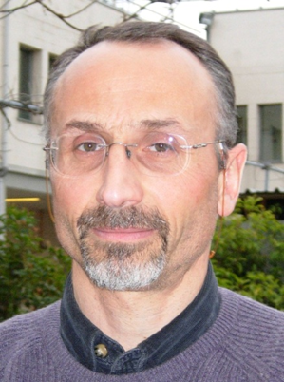

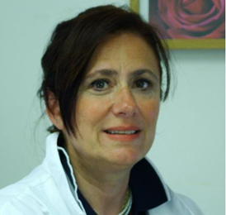
LIFE13 ENV/IT/000461 – EVERGREEN
Monitoring visit and 6th month Meeting – 2015, April 28th
DISPAA, University of Florence
Coordinating beneficiary research units
Dept. of Chemistry
Dept. of Biology
Dept. of Statistics
Genexpress
Arboriculture
Molecular Plant Pathology

Slide 37

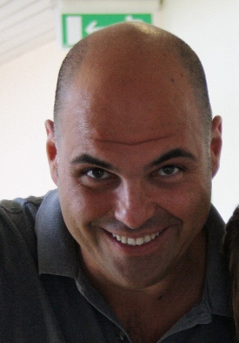
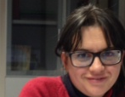
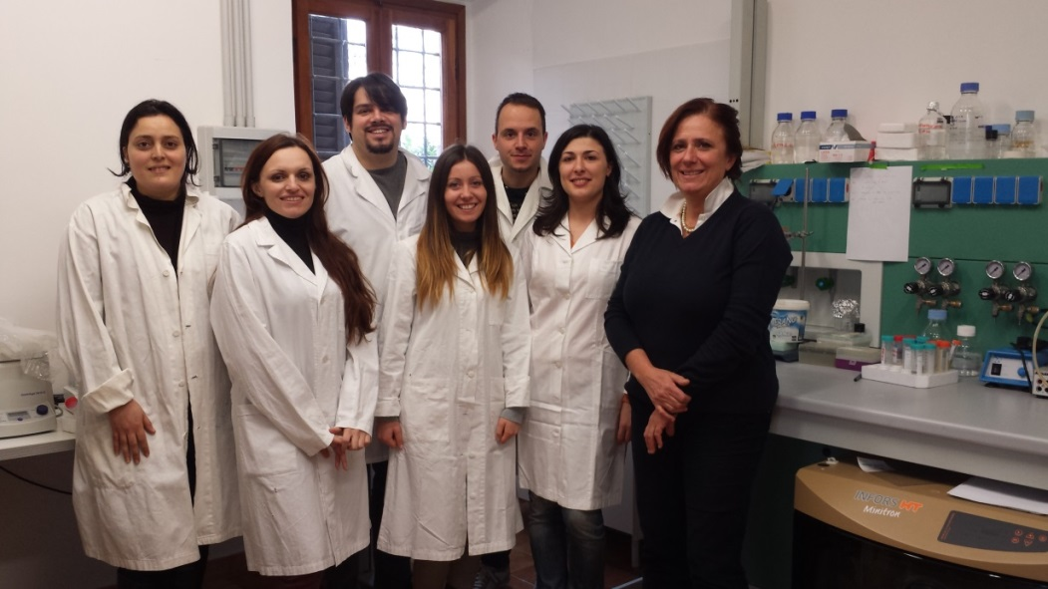
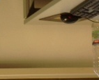
LIFE13 ENV/IT/000461 – EVERGREEN
Monitoring visit and 6th month Meeting – 2015, April 28th
DISPAA, University of Florence
Coordinating beneficiary research units

Slide 38



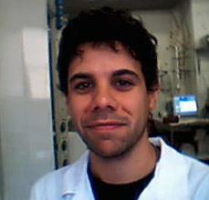
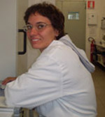
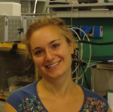
LIFE13 ENV/IT/000461 – EVERGREEN
Monitoring visit and 6th month Meeting – 2015, April 28th
DISPAA, University of Florence
Coordinating beneficiary research units

Slide 39

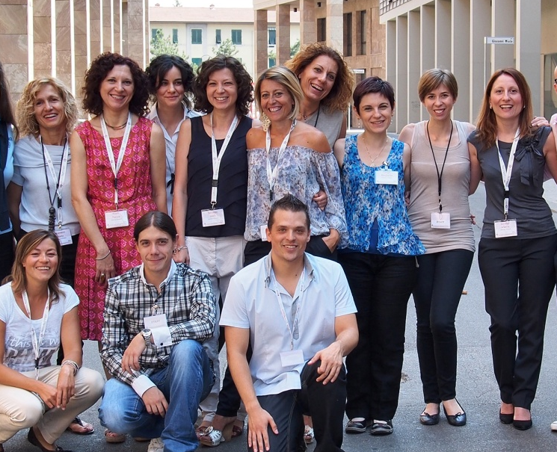
LIFE13 ENV/IT/000461 – EVERGREEN
Monitoring visit and 6th month Meeting – 2015, April 28th
DISPAA, University of Florence
Coordinating beneficiary research units
PhytoLab

Slide 40

LIFE13 ENV/IT/000461 – EVERGREEN
Monitoring visit and 6th month Meeting – 2015, April 28th
DISPAA, University of Florence
TECHNICAL ACTIVITIES CARRIED OUT
B. Implementation actions
B2 Demonstration of the qualitative and quantitative yields of extraction process for the recovery of high quality polyphenolic molecules from not edible vegetable biomass and waste at laboratory scale
B3 Demonstration of the biological and of the chemical stability of the crude polyphenolic extracts and of their fractions, recovered from not edible vegetable biomass and waste, at laboratory scale
B4 Demonstration of the biological activity of the high quality polyphenolic extracts recovered from not edible biomass and waste, against plant pathogenic bacteria and nematode, in planta
B6 Demonstration of the null toxicity profile of the high quality poly-phenolic bioactive molecules recovered from vegetable not edible biomass and waste, on model organisms and microorganisms.

Slide 41
LIFE13 ENV/IT/000461 – EVERGREEN
Monitoring visit and 6th month Meeting – 2015, April 28th
DISPAA, University of Florence
TECHNICAL ACTIVITIES CARRIED OUT
C. Monitoring of the impact of the project actions
C2 Monitoring of the absence of side effects for the high quality standardised polyphenolic preparations on common targets of any living organism at laboratory level
C3 Monitoring of the absence of a direct selection operated by the polyphenolic preparations towards the emergence of bacteria resistant to the polyphenolic molecules themselves, at laboratory level

Slide 42
LIFE13 ENV/IT/000461 – EVERGREEN
Monitoring visit and 6th month Meeting – 2015, April 28th
DISPAA, University of Florence
Action B2
1st October 2014 - 31st December 2015

Slide 43







VS
BACTERIA PLANTS
DI
disease
Courtesy of E.Colombi, 2012

Slide 44



LIFE13 ENV/IT/000461 – EVERGREEN
Monitoring visit and 6th month Meeting – 2015, April 28th
DISPAA, University of Florence
Type Three Secretion System
HrpA subunits
Buttner & Yang He (2009)
The EMBO Journal (2002) Vol.21 N.8

Slide 45


= HrpA
© 2014 Simone Giuntini

Slide 46

LIFE13 ENV/IT/000461 – EVERGREEN
Monitoring visit and 6th month Meeting – 2015, April 28th
DISPAA, University of Florence
Action B3
1st January 2015 - 31st December 2015

Slide 47

LIFE13 ENV/IT/000461 – EVERGREEN
Monitoring visit and 6th month Meeting – 2015, April 28th
DISPAA, University of Florence
Action B3
1st January 2015 - 31st December 2015

Slide 48

LIFE13 ENV/IT/000461 – EVERGREEN
Monitoring visit and 6th month Meeting – 2015, April 28th
DISPAA, University of Florence
Action B3
1st January 2015 - 31st December 2015

Slide 49

LIFE13 ENV/IT/000461 – EVERGREEN
Monitoring visit and 6th month Meeting – 2015, April 28th
DISPAA, University of Florence
Action B3
1st January 2015 - 31st December 2015

Slide 50

LIFE13 ENV/IT/000461 – EVERGREEN
Monitoring visit and 6th month Meeting – 2015, April 28th
DISPAA, University of Florence
Action B3
1st January 2015 - 31st December 2015

Slide 51


LIFE13 ENV/IT/000461 – EVERGREEN
Monitoring visit and 6th month Meeting – 2015, April 28th
DISPAA, University of Florence
Action B3
1st January 2015 - 31st December 2015
HR inhibition on Tobacco challenged by Pseudomonas savastanoi

Slide 52

LIFE13 ENV/IT/000461 – EVERGREEN
Monitoring visit and 6th month Meeting – 2015, April 28th
DISPAA, University of Florence
Action B3
1st January 2015 - 31st December 2015

Slide 53

LIFE13 ENV/IT/000461 – EVERGREEN
Monitoring visit and 6th month Meeting – 2015, April 28th
DISPAA, University of Florence
Action B4
1st January 2015 - 31st December 2015

Slide 54

LIFE13 ENV/IT/000461 – EVERGREEN
Monitoring visit and 6th month Meeting – 2015, April 28th
DISPAA, University of Florence
Action B4
1st January 2015 - 31st December 2015

Slide 55


LIFE13 ENV/IT/000461 – EVERGREEN
Monitoring visit and 6th month Meeting – 2015, April 28th
DISPAA, University of Florence
Action B6
1st April 2015 - 31st December 2015
Genus Artemia in ecotoxicity testing
Environmental Pollution 144 (2006) 453-462
Test No. 202: Daphnia magna
Acute Immobilization Test
OECD Guidelines for the Testing of Chemicals
Retrieved July 4, 2013

Slide 56

LIFE13 ENV/IT/000461 – EVERGREEN
Monitoring visit and 6th month Meeting – 2015, April 28th
DISPAA, University of Florence
Action C2
1st January 2015 - 31st December 2016

Slide 57

LIFE13 ENV/IT/000461 – EVERGREEN
Monitoring visit and 6th month Meeting – 2015, April 28th
DISPAA, University of Florence
Action C3
1st April 2015 - 31st March 2016

Slide 58
LIFE13 ENV/IT/000461 – EVERGREEN
Monitoring visit and 6th month Meeting – 2015, April 28th
DISPAA, University of Florence
And now,
Dissemination and
Financial issues
Dr. Silvia Borselli
Dr Costantino Raspi

Slide 59
LIFE13 ENV/IT/000461 – EVERGREEN
Monitoring visit and 6th month Meeting – 2015, April 28th
DISPAA, University of Florence

Slide 60
LIFE13 ENV/IT/000461 – EVERGREEN
Monitoring visit and 6th month Meeting – 2015, April 28th
DISPAA, University of Florence

Slide 61
LIFE13 ENV/IT/000461 – EVERGREEN
Monitoring visit and 6th month Meeting – 2015, April 28th
DISPAA, University of Florence

Slide 62
LIFE13 ENV/IT/000461 – EVERGREEN
Monitoring visit and 6th month Meeting – 2015, April 28th
DISPAA, University of Florence

Slide 63
LIFE13 ENV/IT/000461 – EVERGREEN
Monitoring visit and 6th month Meeting – 2015, April 28th
DISPAA, University of Florence

Slide 64
LIFE13 ENV/IT/000461 – EVERGREEN
Monitoring visit and 6th month Meeting – 2015, April 28th
DISPAA, University of Florence

Slide 65
LIFE13 ENV/IT/000461 – EVERGREEN
Monitoring visit and 6th month Meeting – 2015, April 28th
DISPAA, University of Florence

Slide 67
LIFE13 ENV/IT/000461 – EVERGREEN
Monitoring visit and 6th month Meeting – 2015, April 28th
DISPAA, University of Florence

Slide 68
LIFE13 ENV/IT/000461 – EVERGREEN
Monitoring visit and 6th month Meeting – 2015, April 28th
DISPAA, University of Florence

